Slide 1
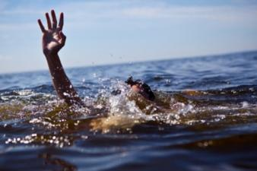
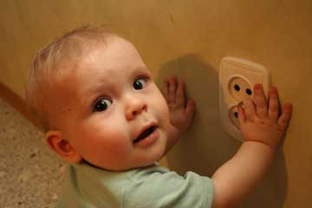
First aid in various emergency situations
Rednenko Victor V., PhD, Associate Professor

Slide 2
First aid algorithm
  Primary examination
  Verify accident scene
  Danger elimination
  Psychological help
Triage
  Neck immobilization
  Casualty removing
  Consciousness check 1
  Consciousness check 2
Bleeding check
  Stop bleeding
  Consciousness check 3
  Activate emergency response system
  Call for help
  Shout for nearby help
  Free airway
  Correct victim position
  Breath check
  Pulse check
  CPR
  Defibrillation
  Secondary examination
  Pain relief
  Wound bandage
  Partial sanitization
  Immobilization

Slide 3
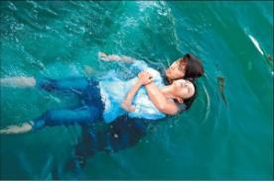
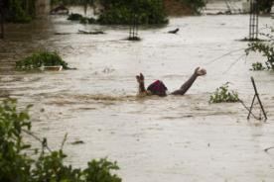
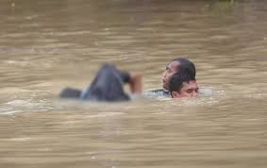
Drowning
Drowning is the 3rd leading cause of unintentional injury death worldwide, accounting for 7% of all injury-related deaths.
There are an estimated 372 000 annual drowning deaths worldwide.
dry drowning
  10-12% victims of drowning at postmortem examination does not find water in the lungs ("dry drowning"). Death in this case was caused by asphyxia, secondary to reflex laryngospasm and closure of the glottis.
wet drowning
  When drowning is accompanied by aspiration of water ("wet drowning") a clinical situation in the future, the more difficult, the more water came into the respiratory tract
If ventilation is restored before the development of irreversible hypoxic brain damage, we can expect a quick and full recovery.

Slide 4
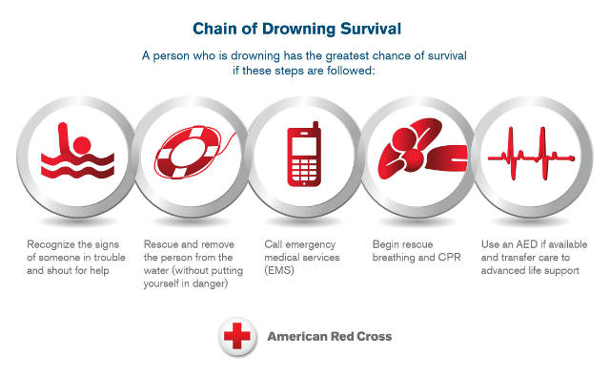
Chain of Drowning Survival

Slide 5
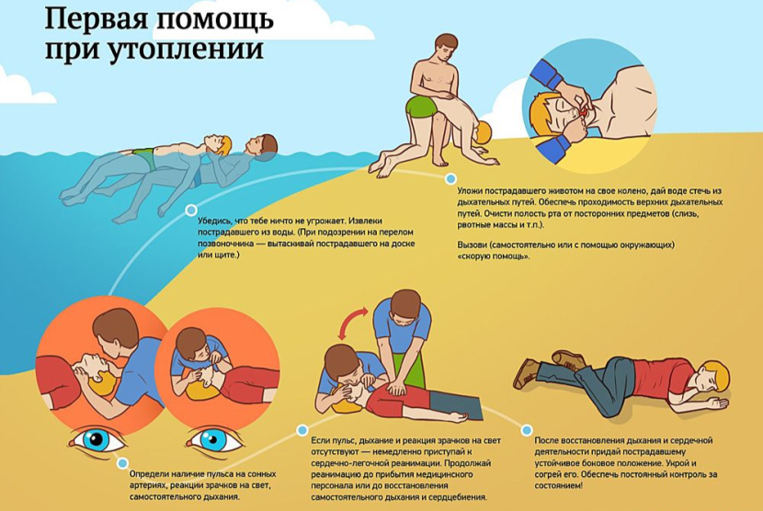
Algorithm

Slide 6
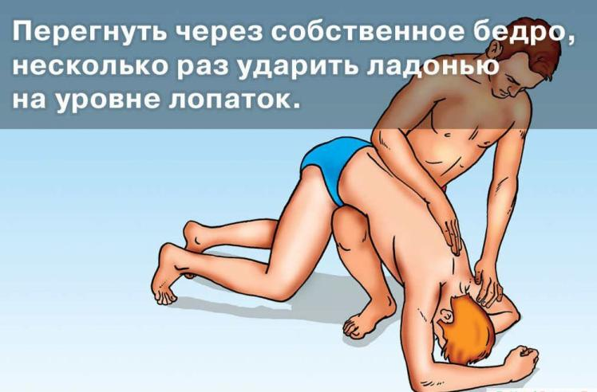
Removal of water from the stomach and upper airways

Slide 7
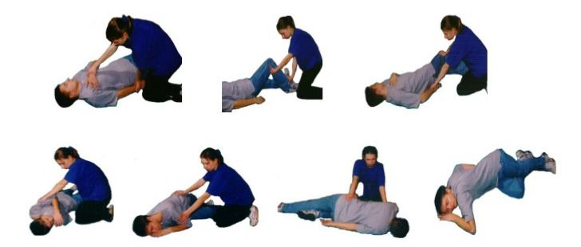
Placing the victim in the safe position

Slide 8
Electric Shock

Slide 9
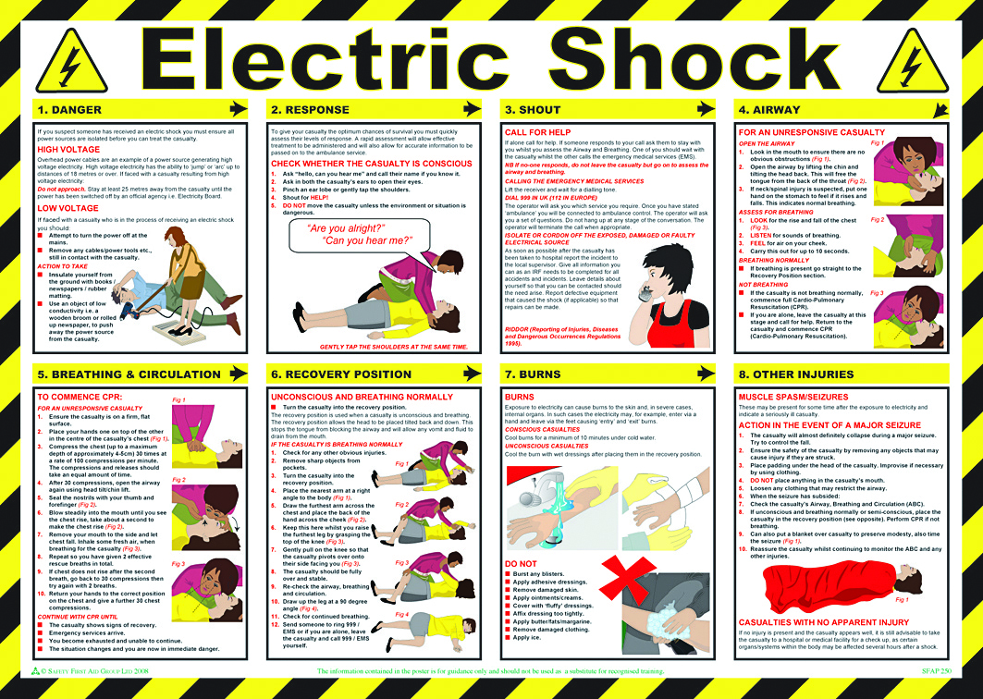

Slide 10
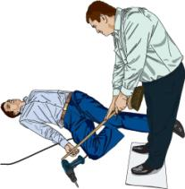
Electric Shock First Aid
DANGER
  If you suspect someone has received an electric shock you must ensure all power sources are isolated before you can treat the casualty.
High Voltage
  Overhead power cables are an example of a power source generating high voltage electricity. High voltage electricity has the ability to ‘jump’ or ‘arc’ up to distances of 18 metеres or over. If faced with a casualty resulting from high voltage electricity:
  Do not approach! Stay at least 25 metеres away from the casualty until the power has been switched off by an official agency i.e. Electricity Board.
Low voltage
  If faced with a casualty who is in the process of receiving an electric shock you should:
    Attempt to turn the power off at the mains.
    Remove any cables/power tools etc., still in contact with the casualty.
Action to take
  Insulate yourself from the ground with books / newspapers / rubber matting
  Use an Electric Shock Rescue Hook or an object of low conductivity i.e. a wooden broom or rolled up newspaper to push away the power source.

Slide 11
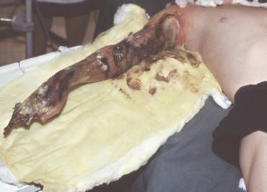
Electric Shock First Aid
BURNS
  Exposure to electricity can cause burns to the skin and, in severe cases, internal organs. In such cases the electricity may, for example, enter via a hand and leave via the feet causing ‘entry’ and ‘exit’ burns.
Conscious casualties
  Cool burns for a minimum of 10 minutes under cold water.
Unconscious casualties
  Cool the burn with wet dressings after placing them in the recovery position.
DO NOT
  Burst any blisters
  Apply adhesive dressings
  Remove damaged skin
  Apply ointments/creams
  Cover with ‘fluffy’ dressings
  Affix dressing too tightly
  Apply butter/fats/margarine
  Remove damaged clothing
  Apply ice.

Slide 12
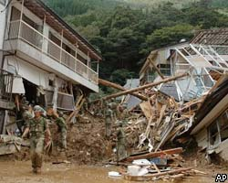
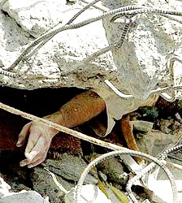
Crush syndrome first aid
Crush syndrome (CS) is a condition in which rhabdomyolysis develops rapidly after the skeletal muscles are released from prolonged pressure, resulting in shock, acute renal failure, and other systemic symptoms.
CS develops when the limbs are subjected to prolonged pressure or tightly restrained and the patient is rescued alive.
This syndrome is sometimes referred to as “traumatic rhabdomyolysis”

Slide 13
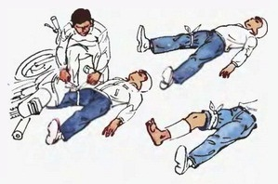
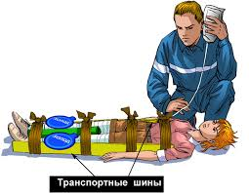
Crush syndrome first aid
to 2 hours
  use tourniquet
  examine the limb
  if limb is viable - use a pressure bandage, immobilize and remove the tourniquet
  If the limb is not viable - leave the tourniquet on the limb
after 2 hours
  use tourniquet and leave it on the limb

Slide 14

Crush syndrome first aid
Perform a primary examination of the scene of a accident
Make sure about present of life signs and absent of the bleeding
Specify the time of compression
  compression less than two hours
  compression more than two hours or compression time unknown
Time of compression is less than two hours
  Free the limbs from under the crushing weight
  Apply a bandage for the injured limb
  Immobilize the limb
Time of compression is more than two hours or compression time unknown
  Apply a haemostatic tourniquet at the compression boundary of the injured limb
  Free the limbs from under the crushing weight
  Remove clothes from the injured limb
  Evaluate the viability of the limb (color, integrity of tissues):
    the limb is viable;
    the limb is not viable: incomplete separation, crushing, signs of severe anaerobic infection (unpleasant smell, dark color of damaged tissues, swelling, necrosis of soft tissues)
Time of compression is more than two hours or compression time unknown and The limb is viable
  Apply a tight bandage on the compressed part of the limb from distal part to proximal one
  Immobilize the limb
  Remove the haemostatic tourniquet
Time of compression is more than two hours or compression time unknown and The limb is not viable
  Apply a bandage for the injured limb
  Immobilize the limb
  Do not remove the tourniquet

Slide 15
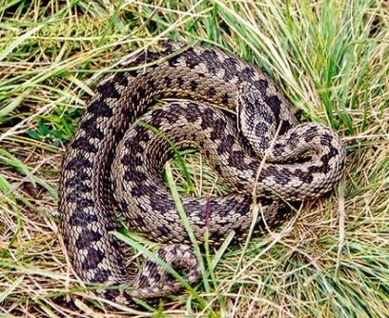
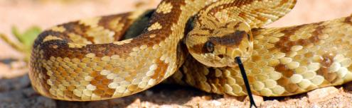
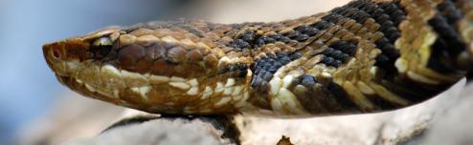
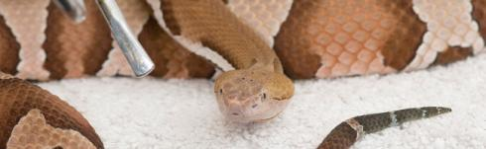
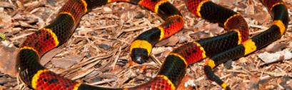
Snakebite
Rattlesnakes
Water moccasins or cottonmouths
Vipera berus
Copperheads
Coral snakes

Slide 16

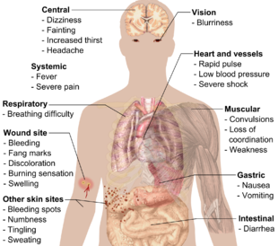
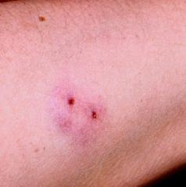
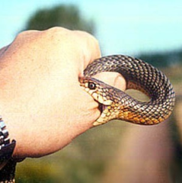
Snakebite

Slide 17
Snakebite first aid
Call 103 immediately.
Note the time of the bite.
Keep calm and still as movement can cause the venom to travel more quickly through the body.
Remove constricting clothing or jewelry because the area surrounding the bite will likely swell.
Don’t allow the victim to walk. Carry or transport them by vehicle.
Do not use a tourniquet.
Do not cut into the snake bite.
Do not use a cold compress on the bite.
Do not give the person any medications unless directed by a doctor.
Do not raise the area of the bite above the victim’s heart.
Do not attempt to suck the venom out by mouth.
Do not use a pump suction device. These devices were formerly recommended for pumping out snake venom, but it's now believed that they are more likely to do harm than good.

Slide 18
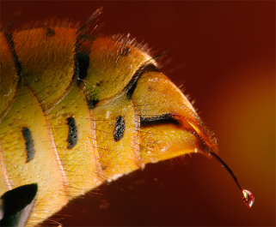
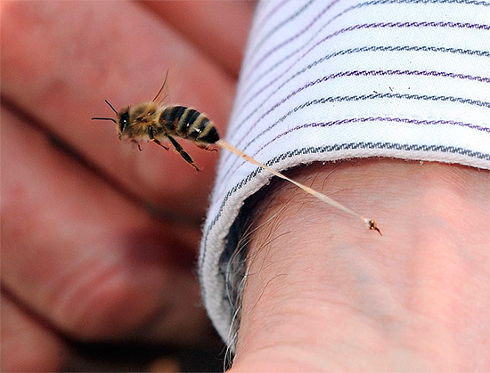
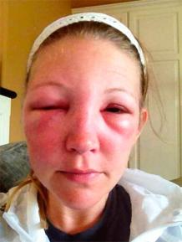
Insect sting

Slide 19
Bee Stings First Aid
Treatment techniques include:
  removing the stinger using a credit card or tweezers (avoid squeezing the attached venom sac)
  cleaning the area with soap and water
  applying ice to ease pain and swelling
  applying creams, such as hydrocortisone, which will reduce redness and itching
  taking an antihistamine, such as Benadryl, for any itching and swelling
If someone you know is experiencing an allergic reaction, immediately call 103. While waiting for paramedics to arrive, you can:
  check the individual’s airways and breathing and begin CPR if necessary
  reassure the victim that help is coming
  remove constricting clothing and any jewelry in case of swelling
  administer epinephrine if the individual has a bee sting emergency kit
  roll the person into the shock position if symptoms of shock are present (This involves rolling the person onto their back and raising their legs 12 inches above their body.)
  keep the individual warm and comfortable

Slide 20

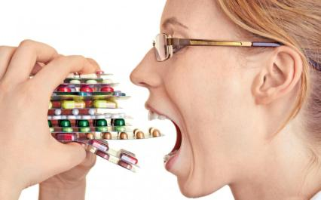
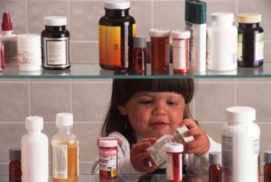
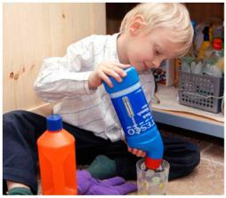
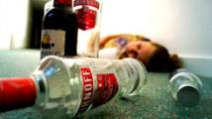
Poisoning

Slide 21
Poisoning: First aid
Swallowed poison. Remove anything remaining in the person's mouth. If the suspected poison is a household cleaner or other chemical, read the container's label and follow instructions for accidental poisoning.
Poison on the skin. Remove any contaminated clothing using gloves. Rinse the skin for 15 to 20 minutes in a shower or with a hose.
Poison in the eye. Gently flush the eye with cool or lukewarm water for 20 minutes or until help arrives.
Inhaled poison. Get the person into fresh air as soon as possible.
If the person vomits, turn his or her head to the side to prevent choking.
Begin CPR if the person shows no signs of life, such as moving, breathing or coughing.
Call 103 for additional instructions.
Have somebody gather pill bottles, packages or containers with labels, and any other information about the poison to send along with the ambulance team.

