Slide 1
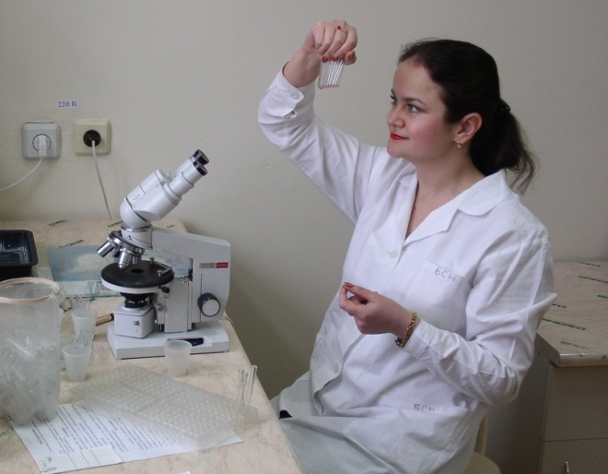
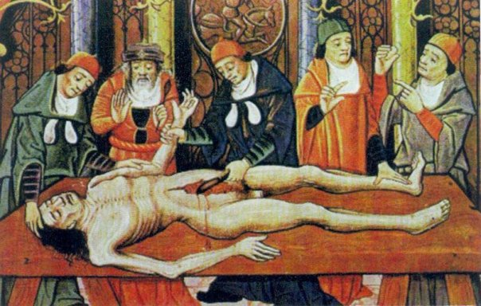
Dying and death.
Postmortem changes.

Slide 2
Теrminal conditions
days – months
Terminal pause
Preagonic
5-10 sec – 3-4 min
Clinical death
Agony
absence
sec – min
hours-days
weeks-months

Slide 3
Теrminal conditions
Preagonic
Terminal pause
Progressive
decrease
of blood
pressure
Depressed
reaction
for stimuli
Heart
sounds
weakening
Clinical death
Hypo- and tachypnoe
Agony
Depression
of consciousness

Slide 4
Теrminal conditions
Preagonic
Terminal pause
Loss of
consciousness
Sudden
respiratory
arrest
Agony
Areflexia
Pulse-
less-
ness
Blood
pressure
is about 0
Clinical death

Slide 5
Теrminal conditions
Terminal pause
Preagonic
Agony
max. activation
of body resources
Clinical death
signs of
consciousness
hyperactivity
of peripheral
reflexes
Convulsions

Slide 6
Clinical death
In this condition no signs of life are discovered as the functions are interrupted for sometime or are reduced to minimum
However life continues and resuscitation may be successful in such cases
Duration up to 4-5 min., at cooling – up to 10 min.
Suspended animation
Voluntarily, practitioners of yoga can pass into a trance death- like in character
Involuntary suspension of animation lasting from a few seconds to half an-hour may be found in newborn infants, drowning, electrocution, cholera, after anesthesia, shock, sunstroke, cerebral concussion, insanity, overdose of barbiturate or, opiates etc., in prolonged illness (e.g. typhoid), or may be induced voluntarily by yogis.

Slide 7
Brain death
Abs. of circulation both in two carotid and two vertebral arteries
(cerebral angiography)
Absence of
consciousness
Abs. of the coordinated movements
30 min
Abs. of the reactions for painful stimuli
Abs. of the cough and pharyngeal reflex
Abs. of the pupils reaction for light
Abs. of the oculocephalogyric and oculovestibular reflex
Abs. of the two-sided corneal reflex
Abs. of spontaneous
breathing
EEC confirmation of
spontaneous and
indused brain activity
2 h
6 h

Slide 8
Modes of tanatogenesis
Shock
Rapid massive
disintegration
of body
Asphyxia
Rapid
cooling
of body

Slide 9
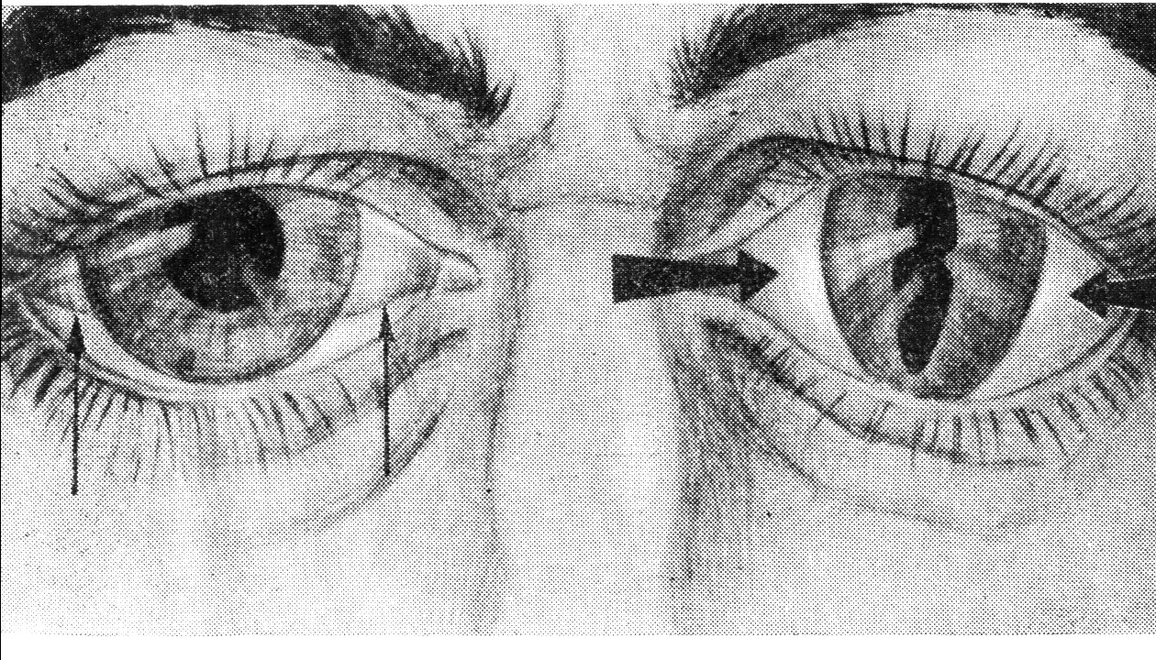
Conclusive signs of death
Livor mortis
Absence
of cardiac
and brain
electrical activity
“Cat’s eye”
phenomenon
The cooling
of body below 23°С
Tache noir on
sclera and cornea

Slide 10
SUPRAVITAL REACTIONS
The first 10 h after death
Mechanical excitability of the skeletal muscles
Up to 24 h after death
Pupil reaction for vegetotropic drug (pilocarpine, atropine)
Up to 12 h after death
Reaction of the facial muscles for electrical irritation
Up to 24 h after death
Pupil reaction for electrical irritation
Up to 20 h after death
Reaction of the sweat glands for adrenalin
Reaction of the skeletal muscles for electrical irritation
Up to 5-7 h after death

Slide 11
Cooling of the body
Rate of cooling
become very slow
For about half to one hour after
death the rectal temperature
falls little or not at all.
t within 4°C of the environment
0.5°C - 0.7°C per hour in tropical
Cooling rate
is relatively uniform in its slope.
Recording the temperature
Ideal place - Rectum
In external
auditory meatus
By inserting a thermocouple
under the liver after
making a small incision
in abdominal wall.
In nasal
passages

Slide 12
Factors affecting rate of cooling
The difference in
temperature between
the body and the medium
The environment of the body
The build of the cadaver
Covering on or around the body
The physique of the cadaver
Accurate formula
cannot be devised
to define rate of heat loss
Determination of temperature
of the body is important
only in cold and temperate
climates

Slide 13
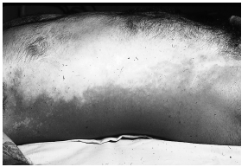
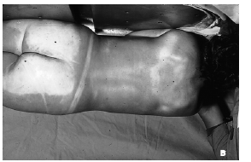
Post-mortem hypostasis
darkening of death
livor
mortis
postmortem
staining
cadaveric
lividity
vibices
subcutaneous
hypostasis
suggilations

Slide 14
intensity depends upon the amount of reduced hemoglobin in the blood
bluish-purple
color to the
adjacent skin
stoppage
of circulation
Accumulation of blood
in the toneless capillaries
and venules of the
dependent parts of the body
stagnation
of blood in blood vessels
tendency to sink
by force of gravity
Begins shortly after death,
may not be visible for 0.5-1 hour after death in normal individuals and about for 1-4 hours in anemic persons

Slide 15
Medicolegal importance of the postmortem lividity

Slide 16
Medicolegal importance of the postmortem lividity

Slide 17
The hypostatic areas have a distinct color in certain cases of poisoning
Aniline dyes
Deep Blue/chocolate / copper brown
Arsenic
Brown
Carbon monoxide
Bright cherry Red
Cyanide
Pink
Potassium chlorate, Potassium bicarbonate, Nitrobenzene
Chocolate or Coffee brown
Dinitrophenol
Orange
Hydrogen sulphide
Bluish green
Nitrites
Red Brown

Slide 18
Medicolegal importance of the postmortem lividity

Slide 19
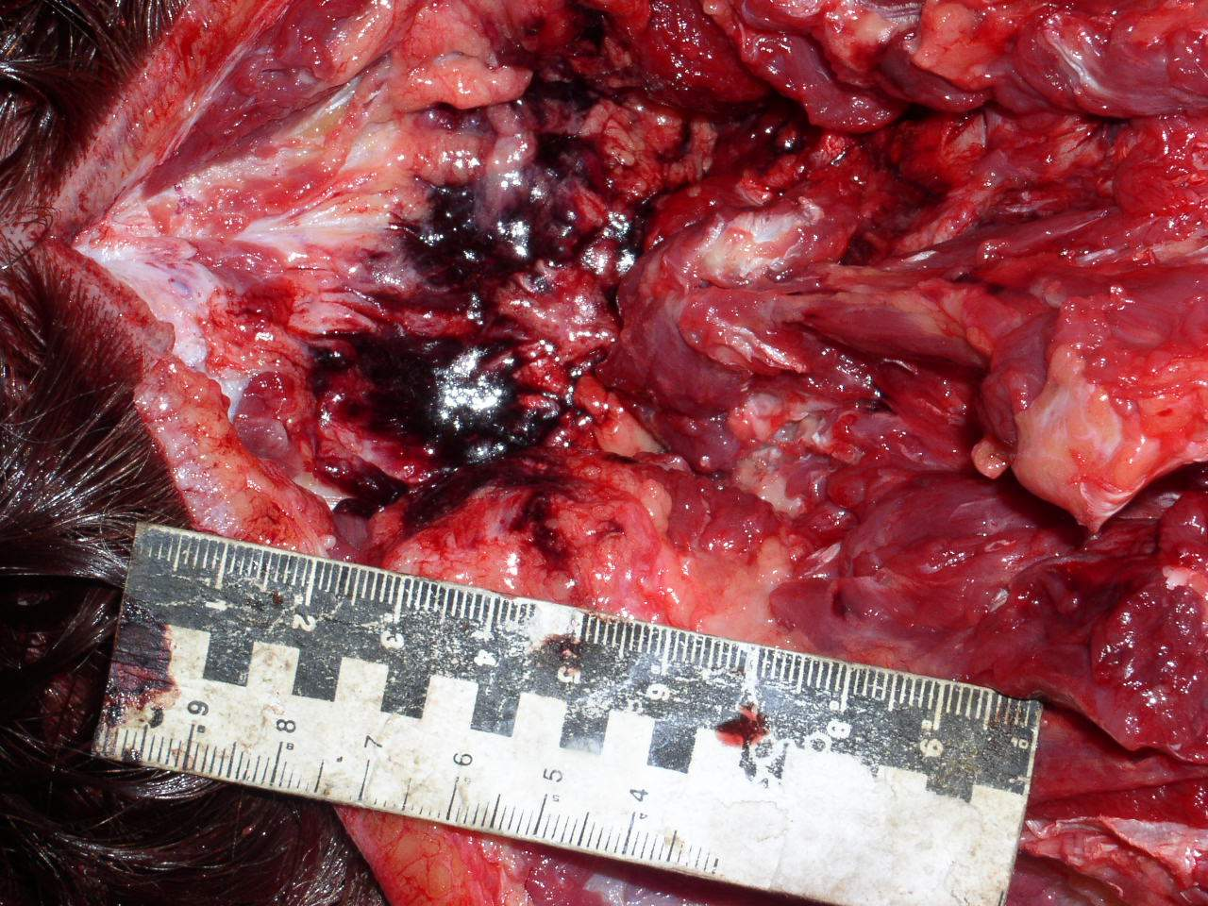
Medicolegal importance of the postmortem lividity

Slide 20
Пятна Лярше – drying up of the sclera and cornea

Slide 21
RIGOR MORTIS (aka cadaveric rigidity)
This is a stage of stiffening of muscles with shortening of the fibers.
Mechanism :
When the ATP is reduced to 85% of the normal, the overlapping portions of myosin and actin filaments combine as rigid links of actomyosin which is viscous and inextensible and causes hardness and rigidity of muscle rigor.
Rigor persists until decomposition of the proteins of the muscle fibres makes them incapable of any further contraction.
The order of appearance of Rigor mortis
All muscles of the body, both voluntary and involuntary are affected.
It first appears in involuntary muscles, the myocardium becomes rigid in an hour.
It begins in eyelids, neck and lower jaw and passes upwards to muscles of the face and downwards to muscles of the chest, upper limbs, abdomen, lower limbs.

Slide 22
RIGOR MORTIS
Time of Onset
In India, it begins one to 2 hours after death and takes further one to 2 hours to develop.
In temperate countries, it begins in 3 to 6 hours and takes further 2 to 3 hours to develop.
Duration of Rigor Mortis
In India, usually it lasts 24 to 48 hours in winter and 18 to 36 hours in summer
It lasts for 2 to 3 days in temperate regions.
Conditions altering the Onset and Duration
In death from diseases causing great exhaustion and wasting e.g. cholera, typhoid, tuberculosis, cancer etc. and in violent death as cut-throat, fire-arm, electrocution, heat stroke, the onset of rigor is early and duration is short.
In poisoning due to Arsenic, Datura, Strychnine and Endrin the duration is longer.

Slide 23
Late postmortem changes: putrefaction
Putrefaction is the final stage following death, produced
mainly by the action of bacterial enzymes, mostly anaerobic
organisms derived from the bowel.
Factors accelerating putrefaction are:
• Septicemia • Asphyxia
• Generalised Inflammatory disease
• Anasarca • Peritonitis
Factors that delay putrefaction are :
• Wasting diseases
• Anemia
• Poisoning by Arsenic, Carbolic acid, Zinc chloride & Strychnine
The chief destructive bacterial agent is CI. welchii.

Slide 24
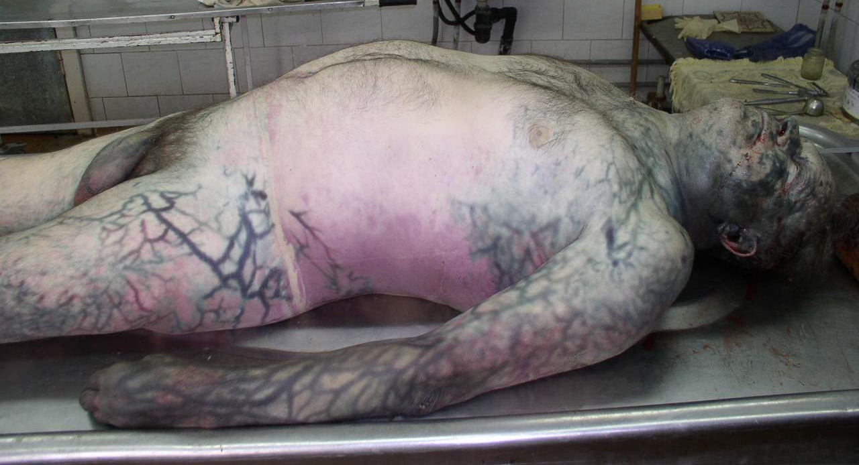
Late postmortem changes: putrefaction

Slide 25
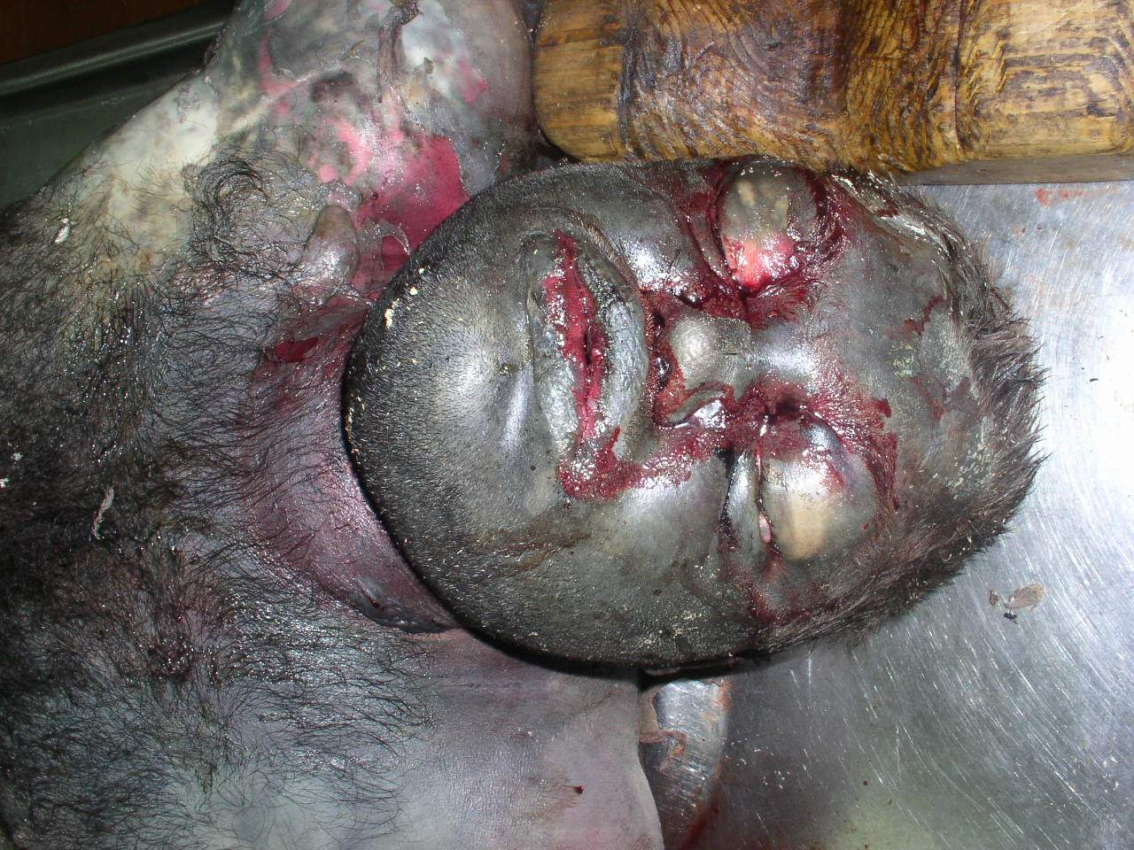
Late postmortem changes: putrefaction

Slide 26
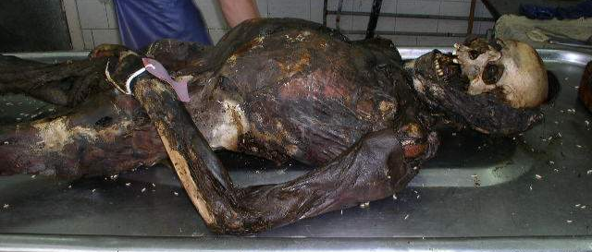
Late postmortem changes : mumification
Desiccation or, Dehydration or drying and shrinkage of the cadaver occurs due to evaporation of water but the natural appearance and features of the body are preserved.
Ideal conditions for
mummification are: • Hot atmosphere.
• Dry environment.
• Free air movement.
• Contact of the body with absorbing media, e.g. sand.
Factors which favor to develop mummification :
• Marked dehydration before death.
• Bodies buried in shallow graves in dry sandy soils (hot dry winds in summer).
• Chronic arsenic or antimony poisoning.

Slide 27
Destruction of the body by animals

Slide 28
MEDICOLEGAL AUTOPSY
Objects:
to find out the time since death.
to find out the cause of death.
to find out the manner of death.
to establish the identity.
in newborn infants to determine live birth and viability

Slide 29
Rules for Postmortem examination
A postmortem examination is never undertaken unless there is a written order from a Police officer, the District magistrate or the Coroner (Mumbai).
The examination has to be meticulous and complete. Partial postmortem is not permitted.
The doctor should routinely record all the positive findings and important negative ones.
All information must be preserved by written records, sketches, relevant photographs and radiographs if possible.
As far as possible, the examination should be conducted in daylight, and not in artificial light.
After the autopsy is completed, and an opinion formed as to the cause and mode of death, the doctor prepares a detailed postmortem report in triplicate. One copy is sent to the investigating police officer, another to the Superintendent of police/Magistrate, and the third retained as office copy.

Slide 30
Negative (obscure) autopsy
gross examination
microscopic examination
fail to reveal a cause of death
laboratory analyses
toxicological analyses
Majority of obscure autopsies are in young adults
2- 5% of all autopsies are negative

Slide 31
Causes of negative autopsy
The presence of specific
marks may be missed
Inadequate external
examination
Lack of
toxicological
analysis
needle marks
snake bites insect bites
electrocution
Inadequate history
vagal inhibition
status epilepticus
Absence of any
anatomical findings
hypersensitivity reaction
Lack of
training
of the doctor
Inadequate internal
examination
Pneumothorax
Insufficient
laboratory
examinations
The presence of specific
sings may be missed
Air embolism

