Slide 1
The recommendations how to make video films, videoclips, video focuses, multimedia presentations, lectures, sanitary bulletins, posters, instructions, photofocuses, booklets or leaflet on the formation of a healthy lifestyle
The Сhair of Public Health and Public Health Services

Slide 2
1. I and your teacher and give you the topics of practical tasks. 2. You must choose the topic`s number and write it near your name. 3. You must choose and make something of it: video films, videoclips, video focuses, multimedia presentations, lectures, sanitary bulletins, posters, instructions, photofocuses, booklets. .

Slide 3
Multimedia presentations
The presentation
– the most important element of the informational culture necessary in your professional activities.

Slide 4
Five characteristics of a good presentation
Interesting content about.
Meaningfulness.
Memorability.
Revitalization.
Balance between the content and the color of presentation (slides).

Slide 5
Tips for making a multimedia presentation
Information about the author:
name, the group number, year.
Plan of presentation.
Introduction.
The main part.
Conclusion.
Bibliography (21st century).
Internet resource with the access date.

Slide 6
Requirements for the construction
1st - title slide
2nd slide - plan of presentation
3rd slide - interaction
The penultimate slide

Slide 7
Requirements for the construction
Past slide - bibliography, references
Slides for the positive mood of your future patients

Slide 8
Requirements to the construction
The presentation should be done by yourself.
The presence of a cover sheet.
Number of slides-20 and more.
The presentation should match the topic.
For labels and captions should be used big font.
You should combine the color of the background and text of your slides.

Slide 9
Requirements for the construction
You can use animation effects.
You must avoid spelling errors and typos.
On the last slide make sure of presence of be used literature list and Web sites.

Slide 10
Requirements for the construction
Fonts for your presentations:
For the headers — not less than 32.
For information — 32.
In tables is allowed — 26-30.

Slide 11
Bibliography
Website Name: The Tobacco Atlas: (Electronic Reference): https://tobaccoatlas.org/country/belarus/#:~:text=The%20economic%20cost%20of%20smoking,to%20early%20mortality%20and%20morbidity. – Access Date: 20.03.2021.
Website Name: Ingham Research Paper: (Electronic Reference): http://hd.ingham.org/Portals/HD/Home/Documents/eh/Tobacco/Tobacco%20and%20You/Sessions/Group%20I/Chapter%206%20How%20much%20does%20smoking%20cost/chap6_handout.pdf. – Access Date: 20.03.2021.
Website Name: Belarus Digest: (Electronic Reference): https://belarusdigest.com/story/the-tobacco-curse-why-belarus-smokes-and-smuggles-cigarettes/. – Access Date: 20.03.2021.

Slide 12
Lecture
The lecture is a logical consistent presentation of scientific question.

Slide 13
The structure of lectures
Title page
Content with page numbers
Introduction
The main part
Conclusion
Bibliography (21st century)
(Internet resources with the access date)
Number of pages - 16 and more.

Slide 14
Preparation for the lectures
Selection of a theme and its correct formulation.
Selection of literature and its study.
Lectures plan.
Self-control (including reading aloud).

Slide 15
Sanitary bulletin
The sanitary bulletin is the text with pictures or photos. The text is written by doctors.
The title should be interesting.
Its content should be directed to the prevention of diseases.
A good sanitary bulletin is the source of medical knowledge on disease prevention and healthy lifestyle.

Slide 16
The requirements for sanitary bulletin
Text for sanitary bulletin is usually divided into 4-6 columns.
In the right corner indicate student name, the group number, date.
Sanitary bulletin is situated in convenient place to observe.

Slide 17
Requirements for sanitary bulletin
Requirements for the title.
Text requirements.
Content requirements.
Requirements for the graphic part.

Slide 18
Poster
The poster is a Visual graphic presentation, which promotes
a healthy lifestyle.

Slide 19
Poster’s requirements
Тhe content should be interesting.
It should not include a lot of text.
The design should be done at the same time simple and catchy.
Do not use many small fragments or details.

Slide 20
Poster

Slide 21
Instruction
The instruction is a means
of Visual communication of information, a summary of the
any question or problem.

Slide 22
Instruction may include
Facts about the problem.
Tips.
Algorithm of actions in certain cases.
The information on addresses and telephone numbers of specialized medical institutions.

Slide 23
Structure of instruction
The title (exact, brief, its purpose is to attract attention).
The lead paragraph (makes reading text further intrigues).
The middle paragraph (develops an understanding and appreciation of the subject responds to all questions).
The final paragraph (makes it clear what action, from a reader is recommended).

Slide 24
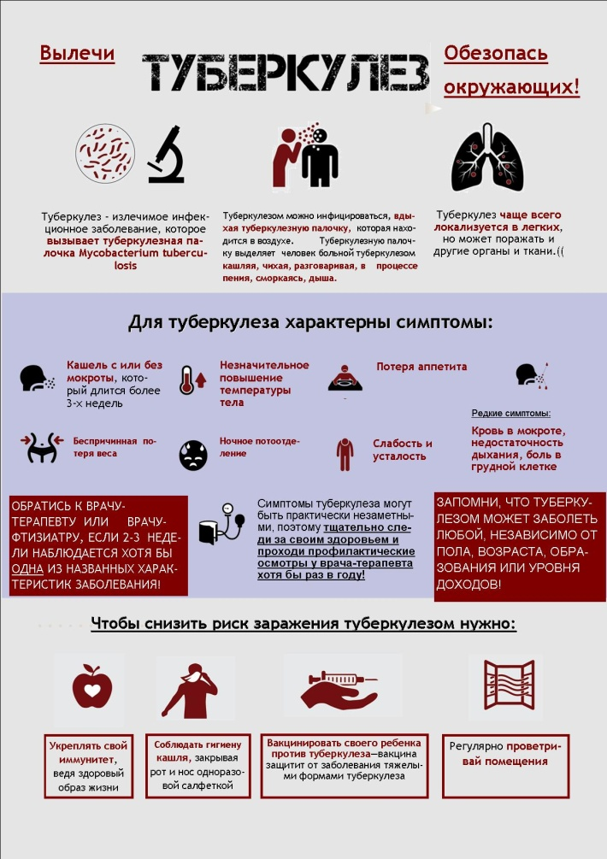
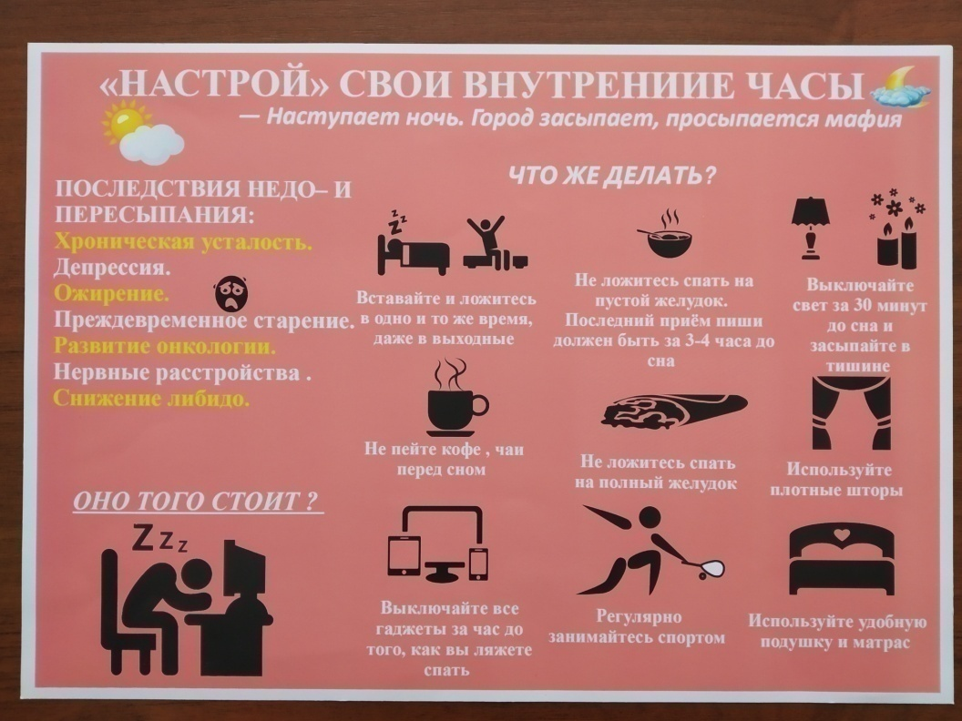
Instruction

Slide 25
Booklet or leaflet
The booklet is printed sheet folded parallel folds in a few pages
so that the text can be read
without cutting.

Slide 26
Recommendations for creating booklets
The booklet can be created using a text editor, Microsoft Word or Microsoft Publisher, which is more convenient for its creation.
The author of the booklet is written in the text of the booklet.

Slide 27
Rules for creating booklets
Booklet design must take into account his purpose of creation, the audience to which it is addressed.
Illustrations should be bright, titles are original .
The most important information should be at the beginning of this booklet.

Slide 28
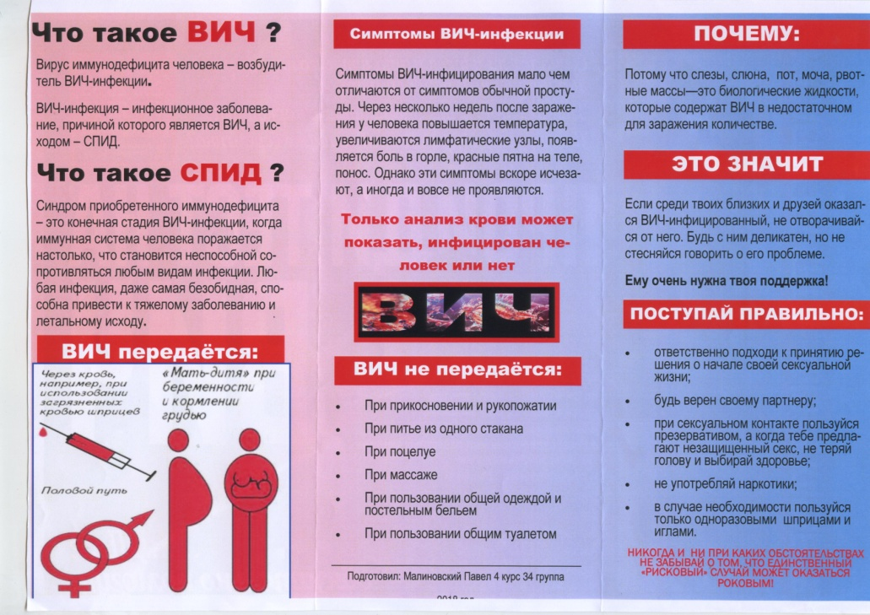
Booklets

Slide 29
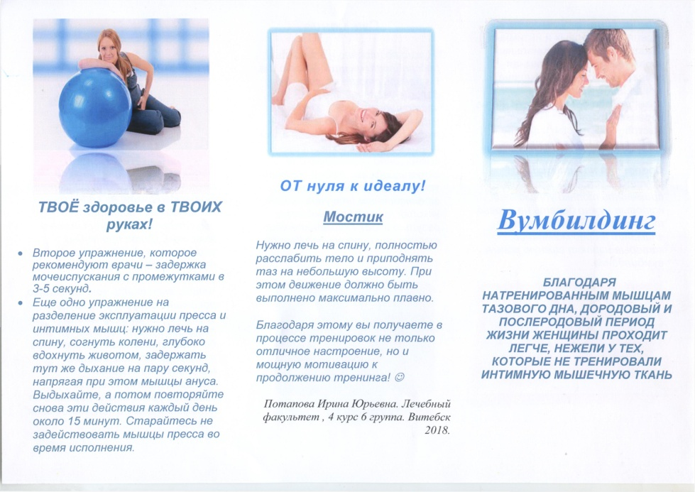
Booklets

Slide 30
Brochures
The brochure is printed book that consists of a small
number pages.
Recommendations for creating of brochures are the same as for booklets.
The author of the booklet is written in the text of the brochure.

Slide 31
Brochures
9
6
3
7
10
4
5
8
11

Slide 32
Video
Video is assessed on
the following criteria:
Originality.
Matching a specified topic.
The Composition.
The presence of sound.
The total emotional perception.

Slide 33
Thank you for your attention!

