Slide 1
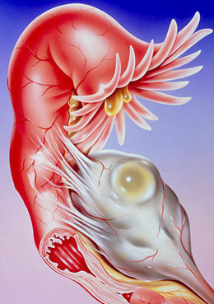
Emergency conditions in gynecology

Slide 2
Diseases of the female reproductive organs, in which the clinical picture of an “acute abdomen” is observed, depending on the cause and pathogenesis, can be divided into the following main groups:
acute bleeding from the internal genital organs: ectopic pregnancy, ovarian apoplexy.
circulatory disturbances in the internal genital organs: torsion of tumor pedicle.
uterine bleeding: on the background of incomplete miscarriage, submucosal fibroids of the uterus, cervical pregnancy, malignant neoplasms of the cervix and body of the uterus.
acute inflammatory diseases of the internal genital organs: adnexitis, parametritis, metroendometritis.
surgical diseases with the symptoms of “acute abdomen”.
injuries of female genital organs
rupture of purulent formation: pyosalpinx, pyovar.

Slide 3
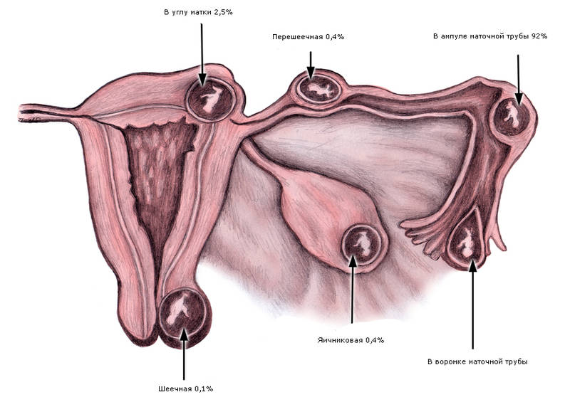
ECTOPIC PREGNANCY
A pregnancy in which a fertilized egg is implanted and develops not in the uterine cavity, but outside it, is called ectopic.
Depending on the place of attachment of the fertilized egg, there are:
tubal,
ovarian,
abdominal pregnancy,
other forms of ectopic pregnancy:
cervical,
isthmical,
in the rudimentary horn
of the uterus,
interligamentous,
mesenteric,
combined,
unspecified.

Slide 4
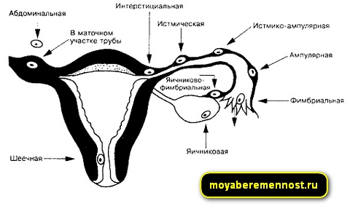

Slide 5
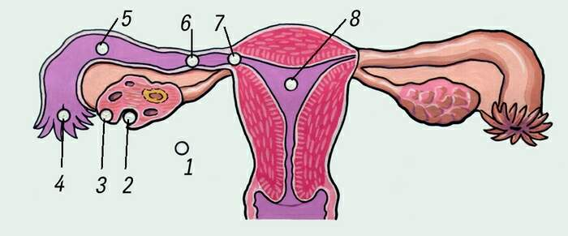
The most common form is tubal pregnancy, which is divided into:
ampullar,
isthmical,
interstitial

Slide 6
Tubal pregnancy
А. Ampullar tubal pregnancy accounts for 80% of tubal pregnancies. Since the ampulla of the fallopian tube is its widest part, the fertilized egg during ampullar pregnancy can reach significant sizes. Pregnancy is usually terminated at 12 weeks. Usually a rupture of the fallopian tube occurs, less often the termination occurs as a tubal abortion. Tubal abortion can cause other types of ectopic pregnancy - abdominal, ovarian or fimbrial.
B. Isthmical tubal pregnancy accounts for about 13% of tubal pregnancies. Pregnancy ends with a rupture of the fallopian tube. Since the isthmus of the fallopian tube is its narrowest part, rupture occurs quite early. The egg is usually released into the abdominal cavity. If the fallopian tube ruptures along the line of attachment of the mesentery, the fertilized egg becomes trapped between the layers of the broad ligament of the uterus, where it can continue to develop.
C. Interstitial tubal pregnancy accounts for about 2% of tubal pregnancies. Due to the great extensibility of the myometrium, interstitial pregnancy can develop up to 4 months. Interruption is accompanied by severe bleeding, which can quickly lead to death. If there is significant damage to the uterus, extirpation is indicated.

Slide 7
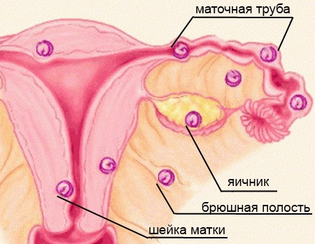
Ovarian pregnancy occurs if a sperm enters the ovary and fertilizes an egg that has not yet been released, or the fertilized egg attaches to the surface of the ovary. The probability of such a pregnancy is less than 1%. It can continue for quite a long time and leads to the rupture of the ovary. Cervical pregnancy is caused by the attachment of the fertilized egg in the cervix or isthmus area. Since the tissues in this place contain a large number of blood vessels and nodes, cervical pregnancy is fraught with large blood loss. The outcome depends on the time of detection. Sometimes, in order to save a woman’s life, the uterus has to be removed.

Slide 8
Abdominal pregnancy can occur in two cases: the primary release of the egg into the abdominal cavity after fertilization, or the secondary entry of the fertilized egg there after a tubal abortion. If an abdominal ectopic pregnancy progresses, then the internal organs located “in the neighborhood” are injured and the tissues are destroyed. However, there are real cases where women managed to bear a viable child who was born through very complex and dangerous surgical delivery operations.

Slide 9
Causes of ectopic pregnancy:
inflammatory diseases of the internal genital organs,
the formation of adhesions, which leads to fusion of the fallopian tube with neighboring organs, its displacement,
STIs (chlamydial infection, mycoplasma, ureaplasma and other pathogenic microbes),
violation of the hormonal function of the ovaries,
congenital changes in the shape of the fallopian tubes (too long and tortuous),
history of induced abortions,
fallopian tube endometriosis,
surgical interventions on the fallopian tubes,
pregnancies obtained through IVF

Slide 10
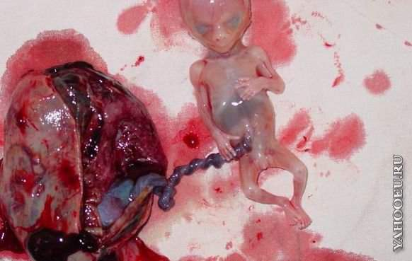
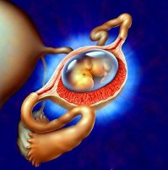
Course of the disease and clinical manifestations
There are two stages during the disease:
progressive ectopic pregnancy,
terminated ectopic pregnancy:
tubal rupture
tubal abortion

Slide 11
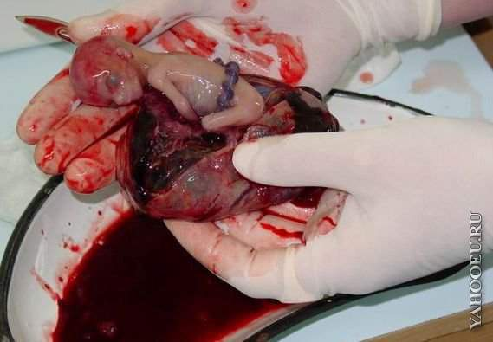
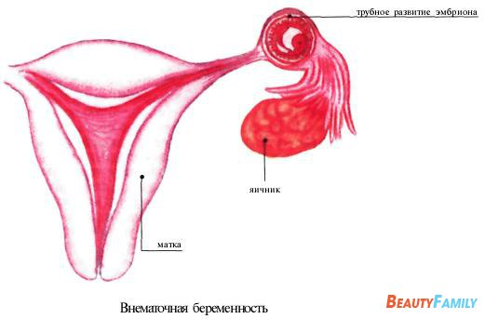
Clinic:
After implantation of the fertilized egg, changes similar to a normal intrauterine pregnancy start in the woman’s organism.
But the fallopian tube cannot create favorable conditions for the growth and development of the fetus, so within 4-7 weeks the ectopic pregnancy is terminated.
Termination of a tubal pregnancy usually occurs as a rupture of the tube or as a tubal abortion.

Slide 12
Pregnancy terminated by the tubal rupture is usually recognized based on the following data:
An acute onset on a background of complete well-being, which in some women (not all!) is preceded by a delay in the next menstruation from one day to several weeks.
Sharp pain appears in the lower abdomen on the right or left.
The abdomen is painful during palpation, the Shchetkin-Blumberg symptom is positive (weakly positive).
The pain is accompanied by nausea or vomiting, dizziness and loss of consciousness.
The woman's general condition progressively worsens until severe shock develops due to internal bleeding.
Blood pressure drops, the pulse is weak and frequent, the skin and mucous membranes are pale.

Slide 13
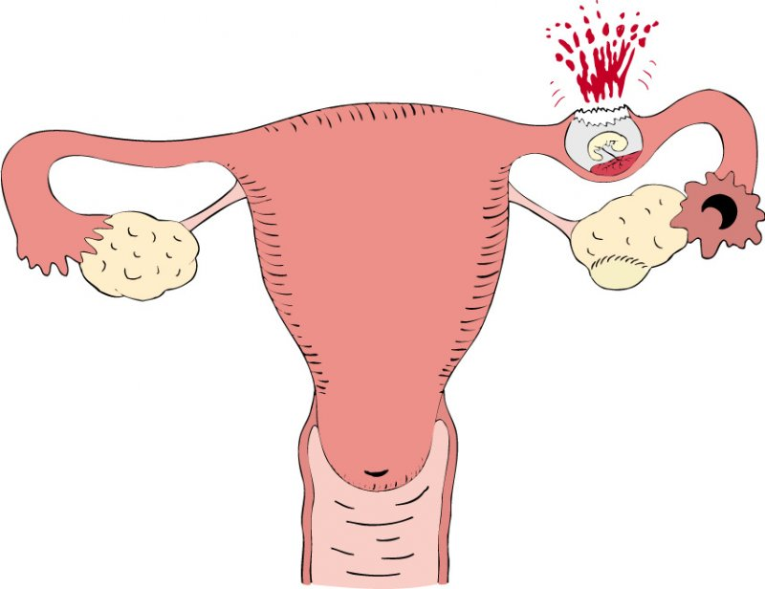
During vaginal examination:
the uterus is slightly enlarged, soft, more mobile than usual
sharp pain during palpation of the posterior vaginal vault
when you try to move the cervix anteriorly, sharp pain occurs

Slide 14
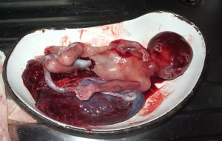
A tubal pregnancy that is terminated as a tubal abortion has an unclear picture.
Tubal abortion, as a rule, takes a long time, often without acute clinical manifestations.

Slide 15
The most informative methods for diagnosing ectopic pregnancy are the following:
Complaints
Anamnesis data
Determination of the pregnancy hormone - chorionic gonadotropin in the blood or urine
Ultrasound examination (preferably transvaginally)
Laparoscopy
Abdominal puncture through the posterior vaginal vault
Histological examination of the endometrium (presence of decidual tissue without chorionic villi)
General blood test

Slide 16
Removed fallopian tube during tubal pregnancy

Slide 17
Removal of the fallopian tube during tubal pregnancy with an embryo

Slide 18
Removal of the fallopian tube during tubal pregnancy with an embryo

Slide 19
Tubal pregnancy on the left

Slide 20
Ovarian apoplexy
Ovarian apoplexy (OA) is a hemorrhage into the ovarian parenchyma, which is accompanied by bleeding into the abdominal cavity.
Bleeding can occur from ruptured ovarian vessels, from a ruptured ovarian hematoma or ovarian cyst.
The causes of apoplexy are not clearly established.
Ovarian rupture occurs due to:
congestive hyperemia,
varicose veins or sclerosis of blood vessels,
sclerotic changes in the stroma
changes in blood vessels and ovarian tissue are the result of previous ovarian inflammation or appendicitis
an important role belongs to disorders of the neurovegetative and endocrine systems.

Slide 21
Preovulatory follicle

Slide 22
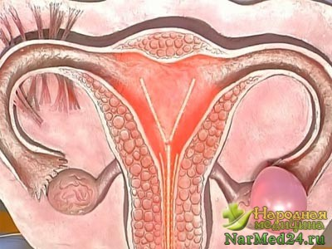
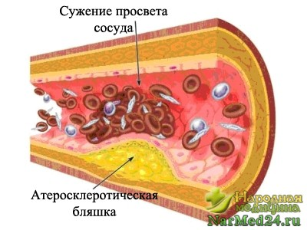
Risk factors:
abdominal trauma
sexual intercourse
lifting weights
careless surgical interventions and medical examinations
mechanical compression of blood vessels by pelvic tumors
horse riding, etc.

Slide 23
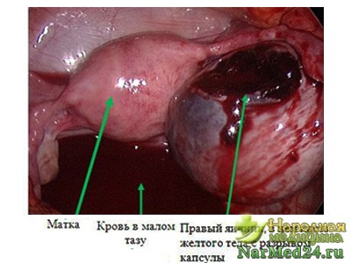
Clinic:
The disease often develops suddenly, on the background of complete health.
Sharp pain appears in the lower abdomen or in one of the iliac regions, radiating to the leg or anus, to the sacrum.
If bleeding into the abdominal cavity is massive, then symptoms of secondary anemia develop: the skin and mucous membranes become pale, the pulse is rapid, and blood pressure drops.
Shock with loss of consciousness is possible.
Body temperature is normal.

Slide 24
Forms of OA
Depending on the severity of certain symptoms, ovarian apoplexy is divided into the following forms:
Painful (pseudoappendicular). The most common symptom is severe pain accompanied by nausea, which is why this form of ovarian apoplexy is often mistaken for an attack of appendicitis;

Slide 25
Hemorrhagic (anemic). The leading symptoms of ovarian apoplexy in this form are signs of internal bleeding: pallor, weakness, dizziness.
Mixed, combining the symptoms of ovarian apoplexy of both previous forms.

Slide 26
Diagnostics:
Carefully collected medical history
Complaints
The onset of the disease is taken into account
Palpation of the abdomen is painful, symptoms of peritoneal irritation.
Pain during palpation is more pronounced in the lower abdomen. Often an attack of pain is accompanied by nausea and vomiting.
Percussion of the abdomen can detect free fluid in the abdominal cavity (blood).
Bimanual examination. The uterus is not enlarged, the appendages - on the one hand - are normal, on the side of the disease the ovary is painful, enlarged, often cystic.
Displacement of the cervix and the entire uterus causes sharp pain.
With heavy bleeding, overhanging and soreness of the vaginal vaults is noted.

Slide 27
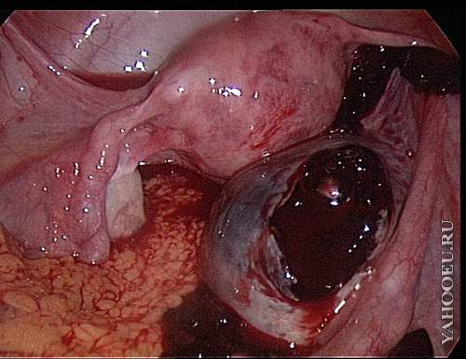
Additional methods:
ultrasound
laparoscopy
puncture through the posterior vaginal vault
GBT, blood group, Rh factor

Slide 28
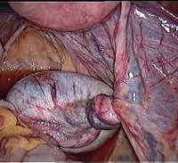
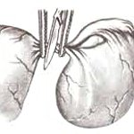
Torsion of tumor pedicle
Torsion of the pedicle of an ovarian tumor is a complication that develops as a result of inversion or bending of the anatomical structures that form the movable pedicle of the ovarian tumor.

Slide 29
The most common occurrence is torsion of the pedicle of an ovarian tumor (up to 20% of all ovarian tumors). But the pedicle of any tumor of the genital organs, for example, a subserous fibromatous node of the uterus, can also twist.
The reasons for tumor torsion are not always clear. They more often occur in multiparous women with a flabby abdominal wall and a large volume of the abdominal cavity.
Contributing factors may be:
abdominal trauma
sudden movements
dancing (sudden stop of rotational movement of the body)
gymnastic exercises
physical stress
pregnancy and postpartum period
rapid intestinal peristalsis.

Slide 30
Clinic:
If torsion occurs slowly, the blood flow through thin-walled venous vessels is initially disrupted, which leads to venous stagnation.
The tumor increases in size, hemorrhages occur, and the tumor may even rupture with bleeding into the abdominal cavity. The color of the tumor becomes dark cherry and then brown.
In case of more significant torsion of the tumor pedicle, blood stops flowing through the arterial vessels.
The tumor is deprived of nutrition and the processes of necrosis begin in it. This can lead to putrefactive decomposition of the tumor, peritonitis and death of the patient (if the necessary medical care is not provided in time).

Slide 31
Torsion of the pedicle of an ovarian tumor

Slide 32
In case of a complete torsion of the tumor pedicle, symptoms of an “acute abdomen” are determined.
The disease begins suddenly, with sharp pain in the lower abdomen.
Pain may radiate to the leg and lower back.
Tension of the anterior abdominal wall, positive Shchetkin-Blumberg sign.
Nausea, vomiting, intestinal paresis, stool retention appear, gases pass poorly, and less often - diarrhea.
The patient is restless, there is cold sweat on her face, there is pallor of the skin and mucous membranes.
Body temperature at the beginning of the disease can be normal, then becomes low-grade to elevated.
The patient takes a forced position with the lower limbs bent and brought to the stomach.
2-3 hours after the cessation of blood supply, necrosis of the tumor node develops,
After 4-6 hours, peritonitis may develop.

Slide 33
Patients with torsion are subject to urgent hospitalization and surgical intervention.
Diagnostics:
The diagnosis is established on the basis of a carefully collected history and complaints. The onset of the disease, data from an objective examination, as well as vaginal examination are taken into account.
Delay in tactics can lead to tumor necrosis, infection, its fusion with neighboring organs, and limited peritonitis.
In some cases, delay contributes to the development of diffuse peritonitis. (which will further complicate the scope of the operation).
Additional methods:
ultrasound,
laparoscopy,
culdocentesis,
GBT, blood group, Rh factor.

