Slide 1
Diagnosis of pregnancy. Maternal mortality and ways to reduce it

Slide 2
The indications of pregnancy are generally classified into three groups:
the possible symptoms;
the probable signs and symptoms;
the positive signs.

Slide 3
The possible symptoms:
changes in her body that a woman can identify for herself and tell you about, which may mean she is pregnant, but they could also be caused by something else. You only have the woman’s subjective report on which to base your diagnosis. However, at Health Post level, the possible symptoms are often all the evidence that is available to you in the first three to six months.
The possible symptoms commonly reported by women in the early stages of pregnancy are sometimes also called ‘presumptive signs’ because pregnancy is often ‘presumed’ by the health professional on the basis of these subjective reports. But it is important to remember that they are only possible indicators of pregnancy.

Slide 4
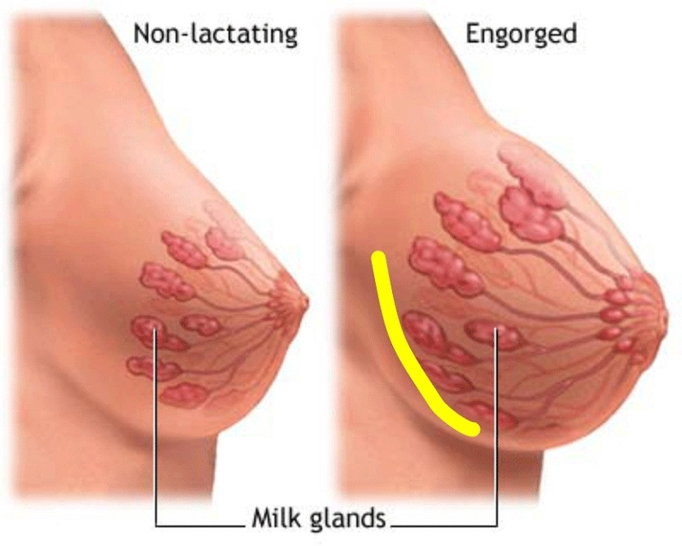
The possible symptoms are:
Breast changes. Pregnant women may report feelings of breast tenderness, fullness, tingling and enlargement and darkening of the areola (the darker circle of tissue around the nipple). During early pregnancy, the glands of the areola enlarge as a result of hormonal stimulation, and the breasts gradually get bigger to prepare to make milk for the baby. But note that breasts often get bigger just before the monthly menstruation in women who are not pregnant.

Slide 5
The possible symptoms are:
Nausea and vomiting. This common symptom occurs in approximately 50% of pregnancies during the first three months. It is usually most severe in the morning, which is why this feeling is often called morning sickness. But it can occur at any time and may be stimulated by cooking odours and spicy smells. Some pregnant women feel nauseous all day. Other possible causes of this symptom are illness or parasites. Severe, frequent vomiting is a danger symptom because the woman can lose weight rapidly. You will learn more about this in Study Session 12.

Slide 6
The possible symptoms:
Tiredness. Women in early pregnancy may report feeling tired and sleepy during the day, and wanting to rest more often than usual when doing their work. Other possible causes are anaemia, poor nutrition, emotional troubles, or too much heavy physical work.

Slide 7
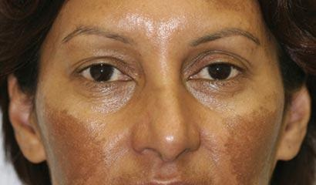
The possible symptoms:
Chloasma. Darkening of the skin over the forehead, bridge of the nose, or cheekbones, is called chloasma. It is most marked in women with dark complexions. Darker patches may also appear on the breast and the belly, especially along the mid-line below the navel. Signs of chloasma usually occur after 16 weeks gestation, (four months of pregnancy) and are intensified by exposure to sunlight, but these changes in the skin are not reliable indicators of pregnancy.

Slide 8
The probable signs and symptoms:
some of these indicators are reported by the woman, but you can also see them for yourself. There is also a pregnancy test that you may be able to conduct, or that could be done at the next level health facility.
These are more reliable than the possible symptoms, but they are not certain indicators of pregnancy. These are changes in the genitalia and the menstrual function. Probable signs and symptoms become apparent on examination of the internal genitalia with specular, vaginal bimanual examination, palpation of the breast.

Slide 9
The probable signs and symptoms:
Missing a menstrual period (amenorrhoea). Missing a menstrual period is often the first symptom that women notice when they become pregnant. If the woman tells you that she has missed a menstrual period (amenorrhoea), or stopped menstruating altogether for some months, it is a fairly good indicator of conception in women who usually have regular menstrual cycles. Other possible causes of amenorrhoea are poor nutrition, emotional troubles, or the menopause (change of life) in older women.

Slide 10
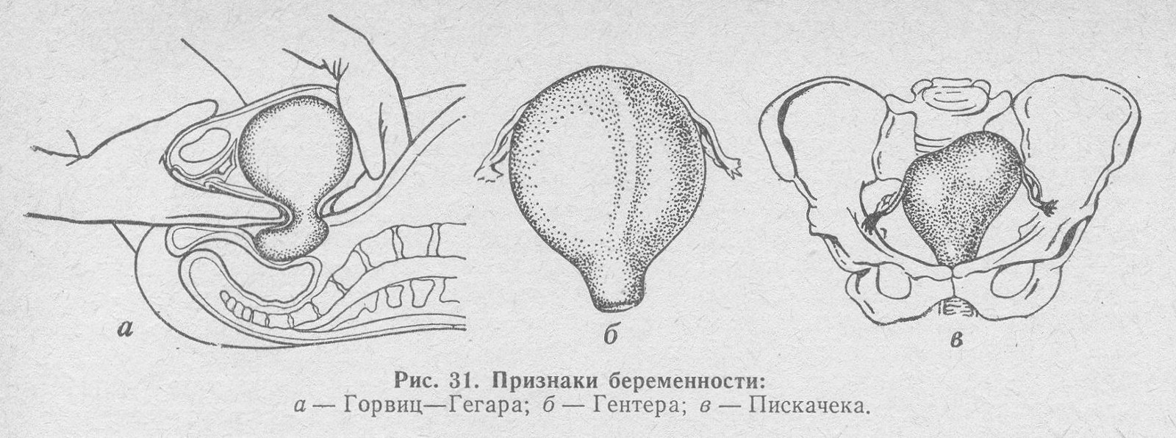
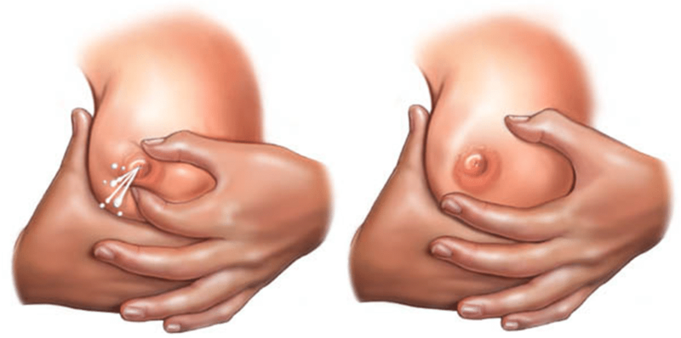
The probable signs and symptoms:
сyanosis of mucosa of the vagina and the uterus cervix;
сhanges in the size, configuration and consistency of the uterus (Enlargement of the uterus, Gorviys-Hegar’s sign, Snegirev’s sign, Piskacek’s sign, Gubarev and Gaus sign) ;
сolostrum can be expressed from the lactiferous ducts opening on the nipples.

Slide 11
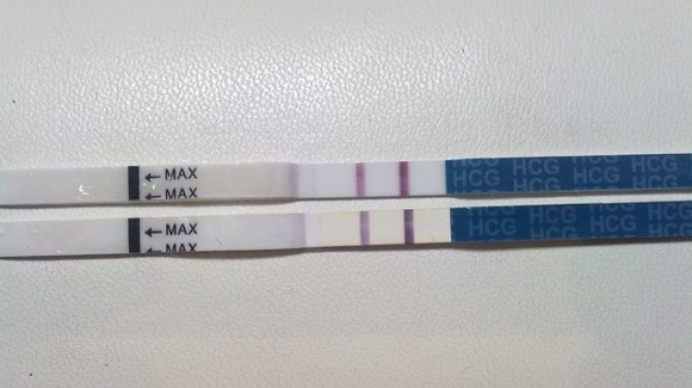
The probable signs and symptoms:
Pregnancy test for human chorionic gonadotropin (HCG). This hormone is produced by a part of the embryo only 8 days after conception, and by the placenta throughout pregnancy. It can be detected by chemical tests that can usually only be done at higher-level health facilities. Pregnancy testing kits may be purchased from pharmacies.
The hormone can be detected in the mother’s blood and urine eight to ten days after conception, or 40 days after the last menstrual period. When people refer to a ‘pregnancy test’, the urine test for HCG is usually what they mean. Although it gives a good indication of pregnancy in most cases, the testing kits may give a false result, especially if they have not been stored properly, or are out of date. Also there are some disease conditions that result in secretion of HCG.

Slide 12
The positive signs:
these are absolute proof of pregnancy, based on objective findings.
Positive (undoubted or absolute) signs of pregnancy sometimes called are ‘sure’ signs. They cannot generally be detected until the second half of pregnancy. They are follows:
fetal heart tones (FHTs);
palpation of the fetus;
fetal motion (Quickening);
ultrasound examination (or sonography).

Slide 13
The positive signs:
Fetal heart tones (FHTs). The normal fetal heart rate is 110-160 beats per minute. The heartbeat may be detected from 18-20 weeks’ gestation by placing a fetoscope on the woman’s belly and listening. Hospitals sometimes have a machine called a hand-held Doppler that can detect fetal heart tones as early as 10 weeks’ gestation.

Slide 14
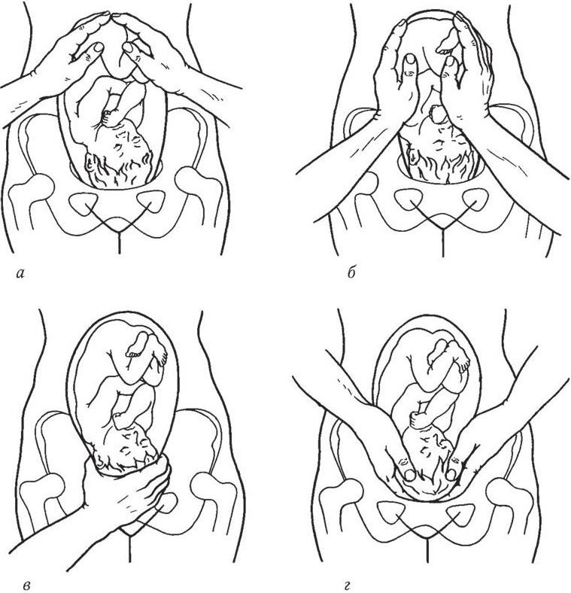
The positive signs:
Palpation of the fetus. You should be able to feel (palpate with your hands) fetal movements through the mother’s abdominal wall at about 18 weeks of pregnancy, and after 22 weeks the fetal outline can be felt.

Slide 15
The positive signs:
Fetal motion (Quickening) may be noted by the examiner in the second half of pregnancy. Most pregnant women start to feel their baby moving very lightly inside them before they are half-way through the pregnancy. This feeling is known as the baby ‘quickening’. Women who have had a baby before are sensitive to these tiny movements sooner than women who are pregnant for the first time. The first perception of fetal movement usually occurs at 18–20 weeks of pregnancy in primigravidas (women who are pregnant for the first time), but it can be as early as 14–16 weeks in multigravidas (women who have had more than one pregnancy). Another possible cause of this symptom is gas in the belly.

Slide 16
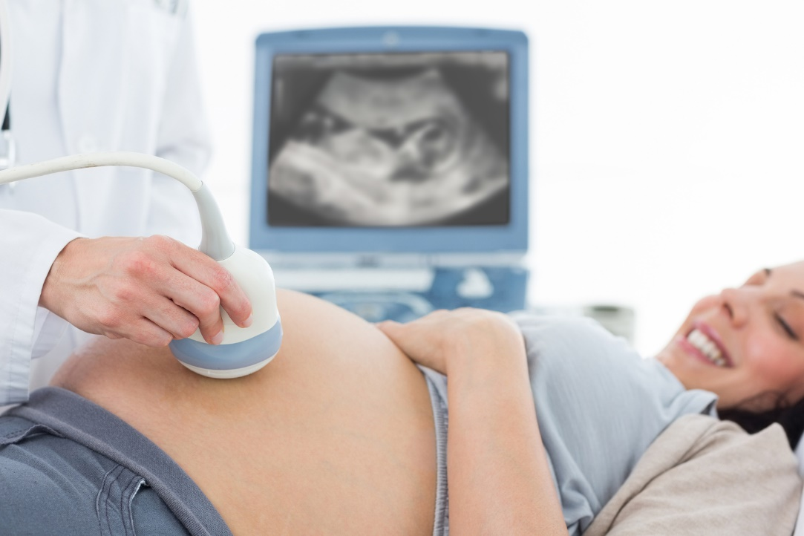
The positive signs:
Ultrasound examination (or sonography) is one of the most useful technical aids in diagnosing and monitoring pregnancy, but it can only be done in a health facility with the right equipment. Sound waves that are so high you cannot hear them are passed through the mother’s abdomen by the machine and they ‘bounce’ back off the baby. A computer turns these sound waves into an image of the fetal outline; the placenta and umbilical cord can also be seen. Fetal wellbeing can be monitored by ultrasound as the pregnancy progresses.

Slide 17
Maternal mortality and ways to reduce it
A maternal death (also known as a maternal mortality) is defined as the death of a woman while pregnant or within 42 days of termination of pregnancy, irrespective of the duration (length) and the site of pregnancy, from any cause related to, or aggravated by, the pregnancy or its management, but not from accidental or incidental causes (i.e. causes of death not related to the pregnancy).

Slide 18
Maternal mortality and ways to reduce it
The five major causes of maternal mortality are:
unsafe abortion;
eclampsia (caused by dangerously high blood pressure during the pregnancy);
obstructed labour;
postpartum haemorrhage (bleeding after childbirth);
puerperal sepsis (bloodstream infection after childbirth).

Slide 19
Maternal mortality and ways to reduce it
Every year the WHO estimates that worldwide around 536,000 women die from complications of pregnancy and childbirth, and that 99% of them are in developing countries. At least 7 million women who survive childbirth suffer serious long-term health problems, and a further 50 million women suffer some adverse health consequences after childbirth. The overwhelming majority of these complications occur in developing countries (WHO Report on Progress Towards Achieving the Millennium Development Goals, published 2009).

Slide 20
Maternal mortality and ways to reduce it
Each year in Africa, 30 million women become pregnant, and 18 million give birth at home without skilled care from a trained health professional. As a consequence, every year over 250,000 African women die because of complications related to pregnancy and childbirth, and four million African women have non-fatal complications of pregnancy (Save the Children, USAID, UNFPA, UNICEF, WHO, Opportunities for Africa’s Newborns: Practical Data, Policy and Programmatic Support for Newborn Care in Africa, 2006).

Slide 21
Maternal mortality and ways to reduce it
The best way of comparing the extent of maternal deaths in different parts of the world is to calculate the maternal mortality ratio (MMR), which tells you the number of maternal deaths that occur in every 100,000 live births. The MMR is internationally recognised as one of the most important indicators of maternal health and the quality of antenatal, delivery and postnatal care in a country.
Although MMRs give public health policy makers a measurement of the magnitude of the problem of maternal deaths, they cannot inform us about what interventions are needed to save women’s lives.

Slide 22
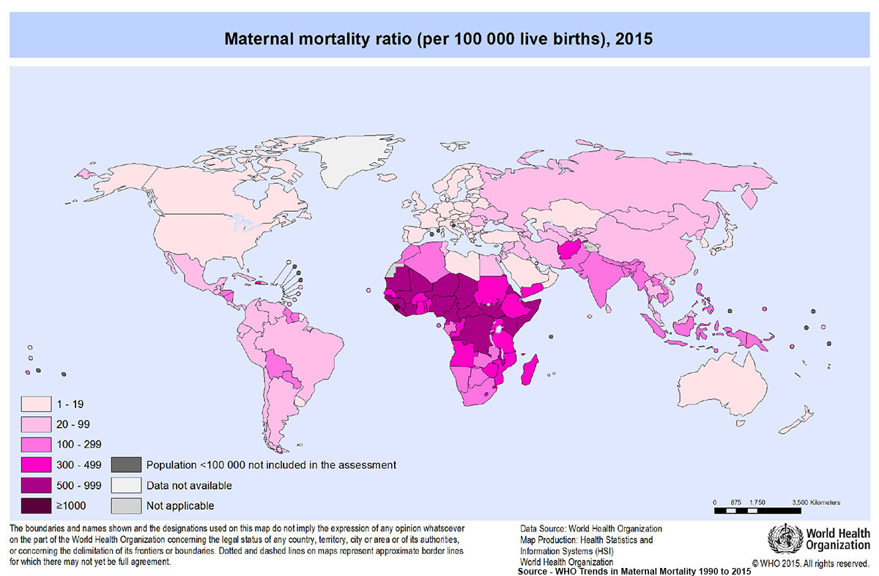

Slide 23
Maternal mortality and ways to reduce it
The Ethiopian Demographic and Health Surveys (EDHS) of 2000 and 2005 have produced estimates of the maternal mortality ratio for the country as a whole. In 2000, for every 100,000 live births in Ethiopia, 871 mothers died because of complications of pregnancy or childbirth. By 2005, this number had fallen to 673 per 100,000 live births — well below the average of 900 per 100,000 live births for Africa as a whole, but still one of the highest in the world. In 2008, the global average MMR was 400 maternal deaths per 100,000 live births, and the European average was only 27 per 100,000 live births.
In Ethiopia in 2005, an estimated 3,119,000 million women gave birth. Figure 1.1 shows that 94% of these births occurred at home — mostly in rural communities like yours (EDHS, 2005).

Slide 24
Newborn deaths and complications
A neonatal death (also known as a newborn death) is defined as a death in the first four weeks of life of a baby who was born alive. Globally, about 3 million newborn deaths occur in the first four weeks of life and there are also 3 million stillbirths. A stillbirth is defined as the delivery of a dead baby after the 24th week of pregnancy. Before 24 weeks the loss of the fetus is usually referred to as a miscarriage.

Slide 25
Newborn deaths and complications
Africa accounts for 11% of the world’s population, but more than 25% of the world’s newborn deaths. Of the 20 countries in the world with the highest risk of neonatal death, 15 of them (75% of the total) are in Africa. Approximately one million African babies are stillborn, of whom at least 300,000 die during labour. A further 1.16 million African babies die in their first four weeks of life, with up to half of these on the first day — and another 3.3 million will die before they reach their fifth birthday. Four million low birth weight babies, and others with neonatal complications survive, but may not reach their full potential (Save the Children, USAID, UNFPA, UNICEF, WHO. Opportunities for Africa’s Newborns: Practical Data, Policy and Programmatic Support for Newborn Care in Africa, 2006).

Slide 26
Neonatal mortality rates
The neonatal mortality rate is the number of deaths in the first four weeks (28 days) of life for every 1,000 babies born alive. This rate is usually referred to as ‘neonatal deaths per 1,000 live births’. Neonatal mortality rates have also been calculated by the EDHS. In 2005, the rate was 39 deaths per 1,000 live births. Ethiopia is one of five countries that contribute to half of Africa’s newborn deaths. The primary causes of these deaths are infection, asphyxia and preterm birth.

Slide 27
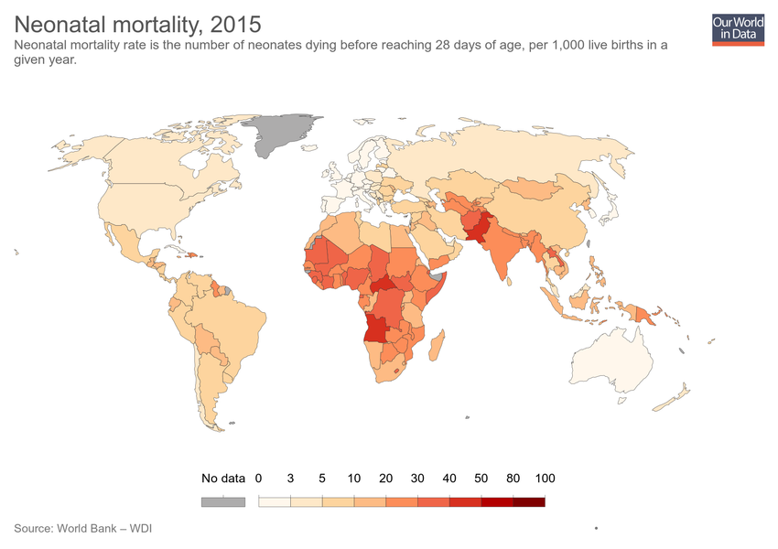

Slide 28
How can maternal and neonatal mortalities be reduced?
The reduction of maternal and neonatal mortality has been globally recognised as one of the World Health Organization’s Millennium Development Goals (MDGs), set in the year 2000. By improving maternal health and nutrition during pregnancy through effective antenatal care, ensuring safe and clean delivery, and providing immediate postnatal care, it is estimated we could prevent about 75% of neonatal deaths, more than 50% of deaths in the first year of life, and 99% of maternal deaths. These improvements can be achieved by effective community level interventions, which include effective communication and health education about antenatal care, the early detection and management of health problems during pregnancy, and about care during labour, delivery and the postnatal period, and the management of newborn and childhood illness.

Slide 29
THANK YOU FOR ATTENTION !

