Slide 1
Physiology of female body at pregnancy

Slide 2
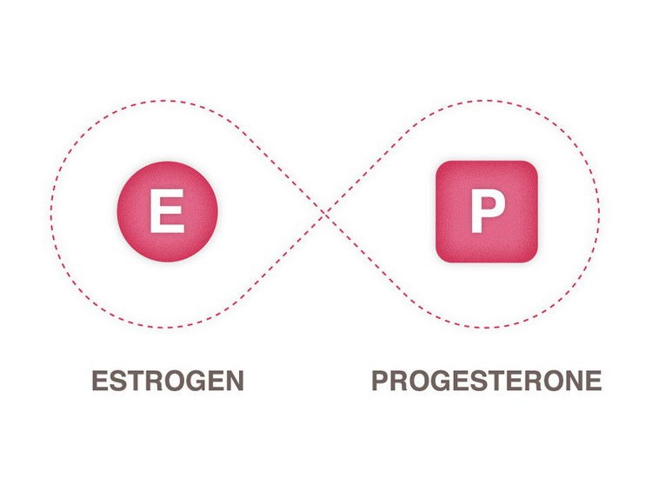
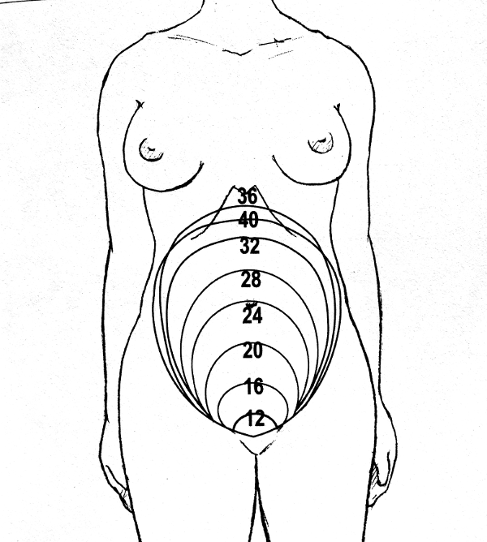
Oestrogen and progesterone are the chief pregnancy hormones.
High levels of progesterone cause some internal structures to increase in size, including the uterus which changes from the size of a small pear in its non-pregnant state to five times its normal size at full term.
The expected increase in weight of the mother in an average pregnancy is 9-12 kg.

Slide 3
A higher circulating blood volume is required to provide extra blood flow through the placenta to the fetus, and the mother also produces more red blood cells.
The increase in blood volume exceeds the increase in red blood cells, so they are diluted in the much larger volume of blood plasma, causing physiological anaemia.
Lower blood pressure is particularly common in early pregnancy because progesterone causes a slight relaxation in the blood vessels. This can cause dizziness and perhaps even a brief loss of consciousness.
A reduction in blood flow back to the heart may lead to oedema — swelling due to fluid collecting in the legs and feet.

Slide 4
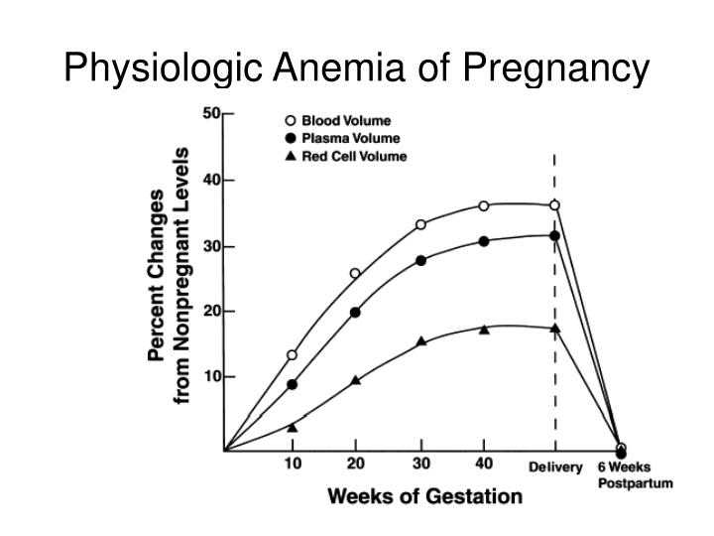

Slide 5
During pregnancy, many women get short of breath because the growing baby crowds the mother’s lungs and she has less room to breathe. She may also experience indigestion as her stomach is pushed higher.
During pregnancy, the muscles in the walls of the gastrointestinal system relax slightly, and the rate at which food moves along the gut is slowed down. This maximises the absorption of nutrients into the mother’s blood, which is good for the fetus, but the mother may also experience nausea or constipation.

Slide 6
Comparison of the chest of pregnant and non-pregnant women

Slide 7
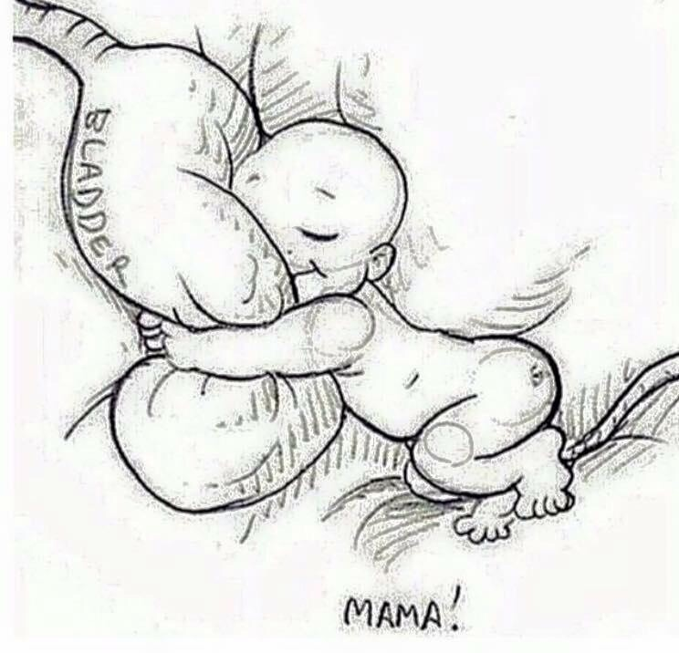
Needing to urinate often is normal, especially in the first and last months of pregnancy, because the growing uterus presses against the bladder. At night, the bladder fills more quickly as fluid (oedema) that collected in the legs during the day is re-absorbed.

Slide 8
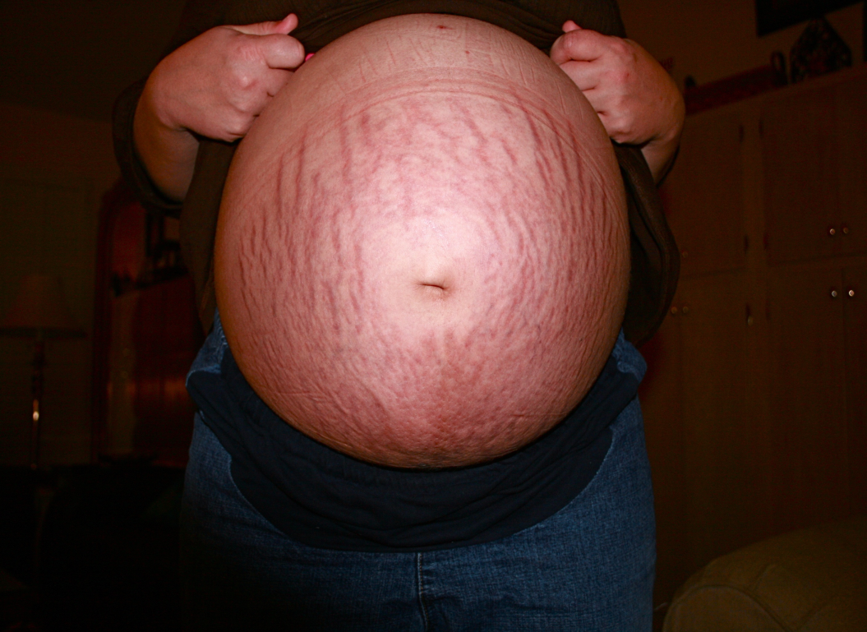
Changes in the woman’s hormones, and mechanical stretching of her growing abdomen and breasts, can cause stretch marks in the skin of these areas during pregnancy. Other skin changes may include brown pigmentation and increased sweating.

Slide 9
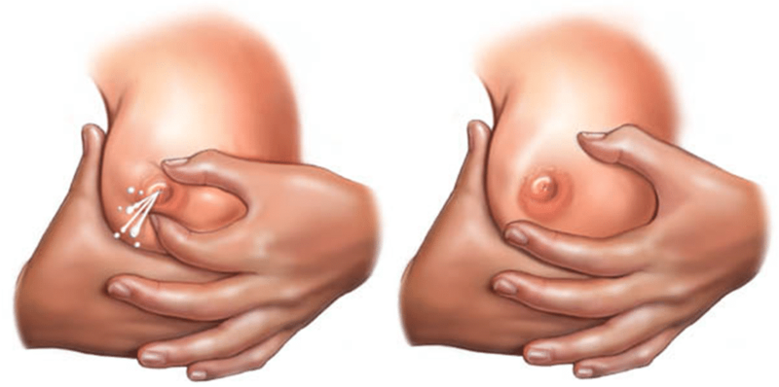
In the second trimester, the breasts begin to produce colostrum — a yellowish secretion that thickens as pregnancy progresses. It is rich in proteins and maternal antibodies, and should always be fed to newborn babies.

Slide 10
Pregnancy-related changes in posture and joints
A pregnant woman’s entire posture changes as the baby gets bigger. Her abdomen transforms from flat or concave (dished) to very convex (bulging outwards), increasing the curvature of her back. The weight of the fetus, the enlarged uterus, the placenta and the amniotic fluid (the bag of waters surrounding the baby), together with the increasing curvature of her back, puts a large strain on the woman’s bones and muscles. As a result, many pregnant women get back pain. Too much standing in one place or leaning forward can cause back pain, and so can hard physical work. Most kinds of back pain are normal in pregnancy, but it can also be a warning sign of a kidney infection.

Slide 11
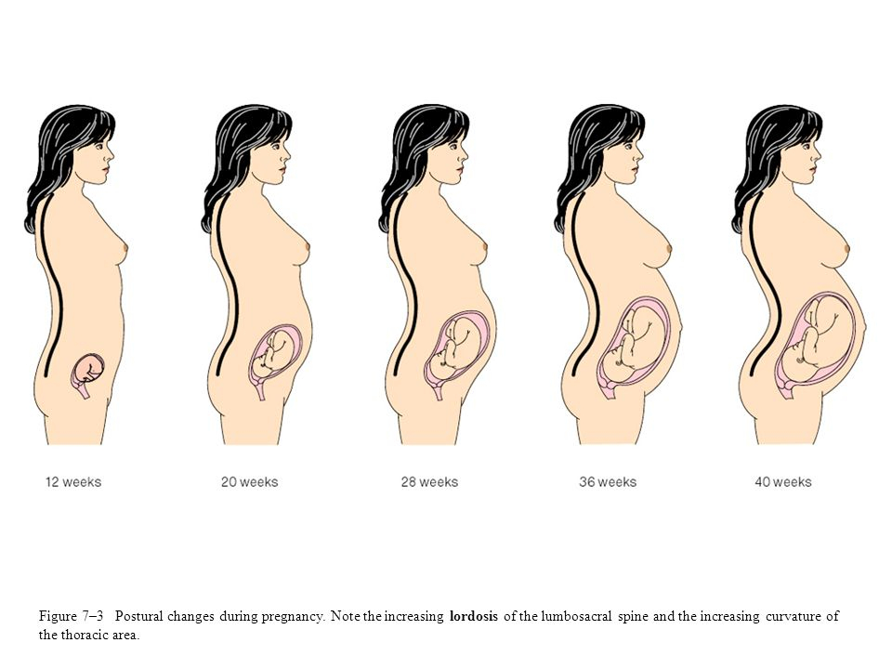
In addition, progesterone causes a loosening of ligaments and joints throughout the body. Pregnant women may be at greater risk of sprains and strains because the ligaments are looser, and because their posture has changed.

Slide 12
Changes in the cardiovascular system
There are several significant changes in this complex system during pregnancy. The heart may increase in size during pregnancy due to an increase in its workload. Changes in cardiac output during pregnancy :
Woman’s condition | Cardiac output (litres per minute)
non-pregnant, resting | 2.5
end of 1st trimester | 5
end of 2nd trimester | 6
full-term | 7
During the second trimester of pregnancy, the mother’s heart at rest is working 40% harder than in her non-pregnant state. Most of this increase results from a more efficiently performing heart, which ejects more blood at each beat.

Slide 13
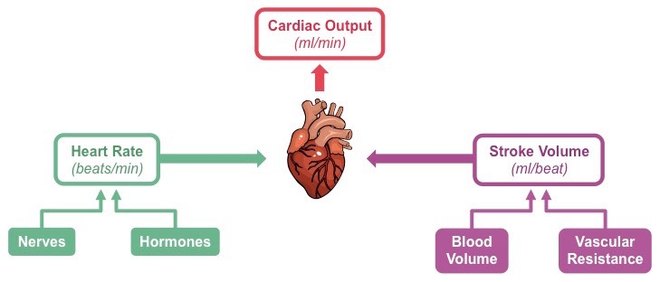
The increase in cardiac output is caused by two changes in how the heart functions:
Increase in the resting heart rate, i.e. the number of heart beats per minute. The heart rate is about 15 beats per minute higher in the pregnant woman.
Increase in the stroke volume, i.e. the volume of blood pumped out of the heart in a single heart beat. It is about 7 millilitres (ml) larger per heart beat in the pregnant woman.

Slide 14
Blood volume
Blood volume (the total volume of blood in the circulation, measured in litres) increases gradually by 30-50 % in the pregnant woman, so by full term she has about 1.5 litres more blood than before the pregnancy. A higher circulating blood volume is required to provide extra blood flow through the placenta, so nutrients and oxygen can be delivered to the fetus. The increase in blood volume is caused by two changes: Increase in the volume of blood plasma (the fluid part of the blood); Increase in the number of red blood cells in the circulation.

Slide 15
The volume of blood plasma increases after about the sixth week of pregnancy. It reaches its maximum level of approximately 50% above non-pregnant values by the second trimester, and maintains this until full term.
The total volume of red cells in the circulation increases by about 18% during pregnancy, in response to the extra oxygen requirements made by the maternal, placental and fetal tissues.

Slide 16
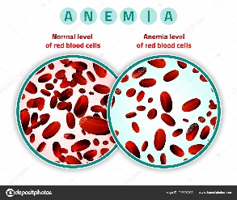
Iron, haemoglobin and anaemia
Although there is a constant increase in the number of red blood cells in the circulation during pregnancy, the increase in the volume of blood plasma is much larger. So even though the pregnant woman has more red blood cells than before she was pregnant, they are diluted in the much larger volume of blood plasma. The WHO recommends that the pregnant woman’s haemoglobin should not fall below 11 grams of haemoglobin per deciliter of blood (Hb 11g/d).

Slide 17
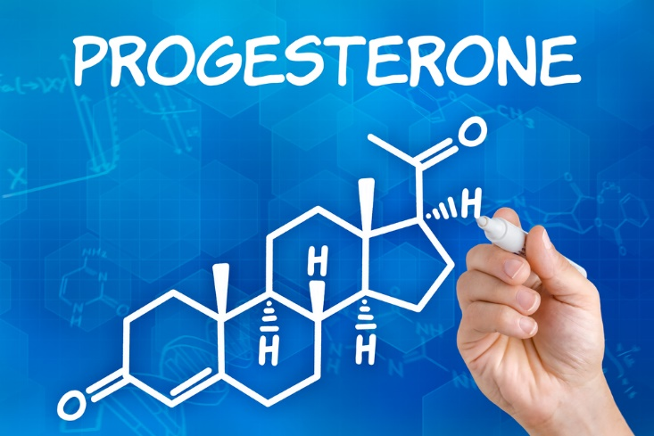
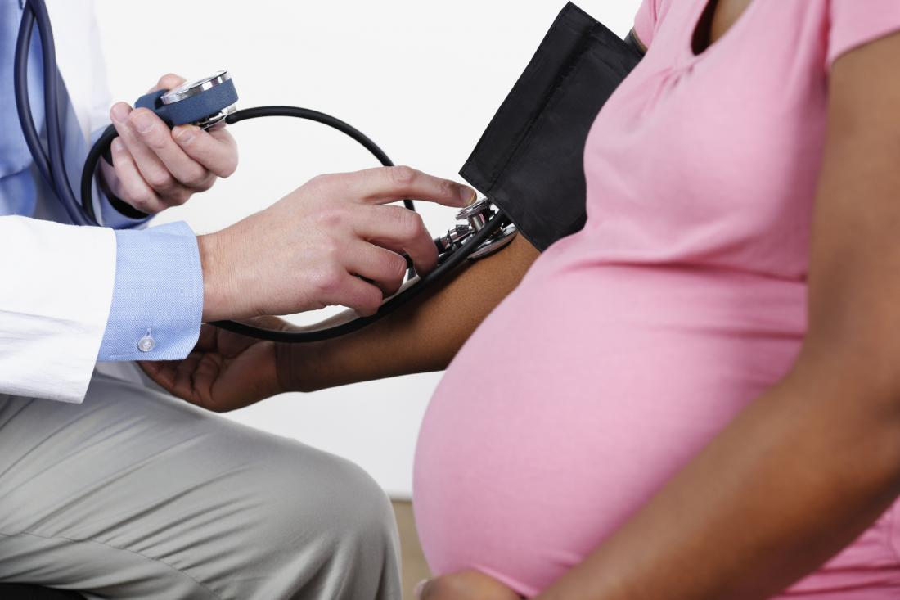
Blood pressure in pregnancy
We said earlier that progesterone causes the ligaments and joints to loosen during pregnancy. It also acts with some other natural chemicals in the body to cause the muscular walls of the blood vessels to relax slightly. The result is that there is less resistance to the flow of blood around the body, because the same volume of blood is circulating in slightly wider blood vessels. Blood pressure (BP) refers to how hard the blood is ‘pushing’ on the walls of the major blood vessels as it is pumped around the body by the heart.

Slide 18
Lower blood pressure is particularly common in early pregnancy. Many women report occasionally feeling dizzy in the first trimester, because less blood and less oxygen is being pumped to the brain. Progesterone can also cause a sudden larger relaxation in the blood vessels, resulting in an acute feeling of dizziness, or even a brief loss of consciousness (passing out).

Slide 19
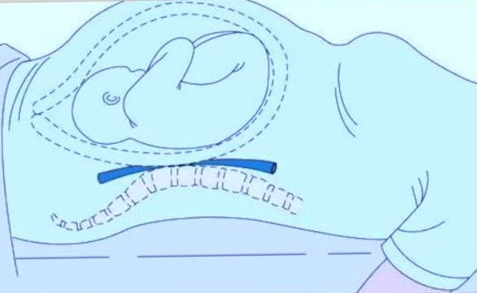
Another cause of dizziness can result from lying flat on the back. This is more common after 24 weeks of pregnancy, but it can happen earlier during twin pregnancies, or conditions that increase the volume of amniotic fluid (waters surrounding the fetus). When a pregnant woman is lying flat on her back, the weight of her uterus and its contents compresses the large blood vessel (vena cava) leading from her lower body to the heart. When this blood vessel is squashed, the blood flow back to the heart is reduced, which in turn leads to a reduction in the blood flow out of the heart to the rest of the body.

Slide 20
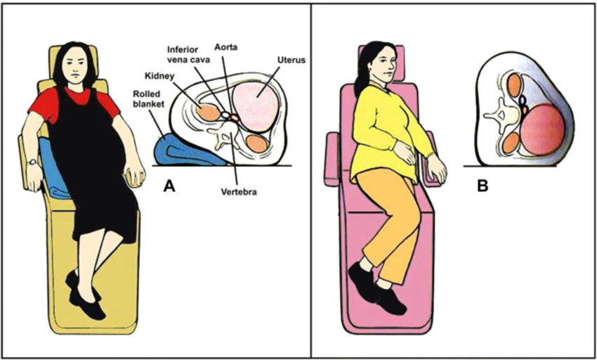

Slide 21
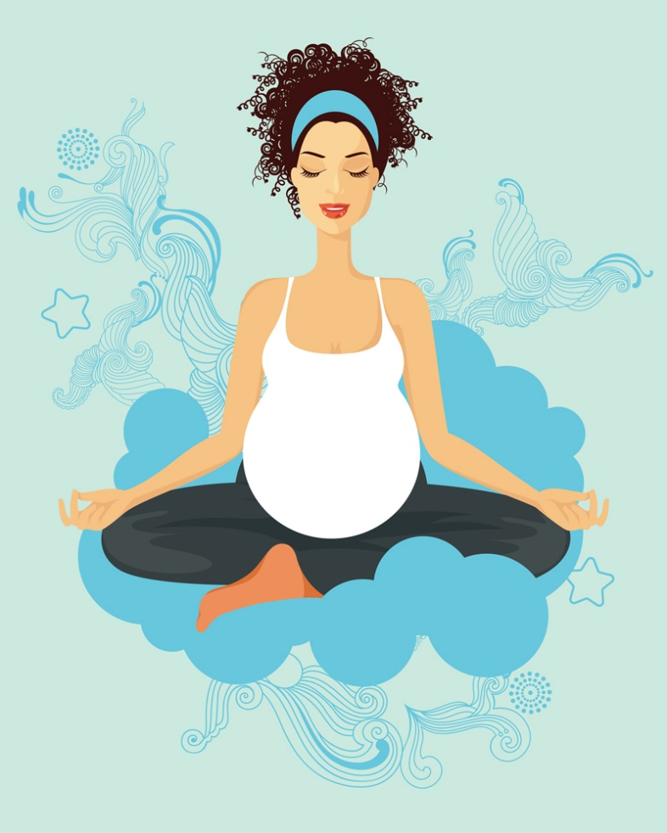
Exercise and blood flow in pregnancy
The weight gain in pregnant women increases the workload on the body from any physical activity. Steady, non-violent exercise is good for the mother because it prepares her body for labour, but sudden strong exercise, or working for too many hours without a break, may make her feel dizzy. This is because the reduced blood pressure and slight physiological anaemia cannot keep pace with the demand of her body for more oxygen. So, having too much or too little exercise should be avoided in pregnancy.

Slide 22
A pregnant woman should not do exercises where she is lying on her back, due to the compression of the major blood vessels returning blood to her heart. Strong exercise may lead to decreased blood flow to the uterus because blood is diverted to the muscles, but this has not been shown to have any long-term effects on the baby. Pregnant women should not exercise vigorously in hot weather, or if it makes them breathless, or if there are known risk factors such as a history of miscarriage.

Slide 23
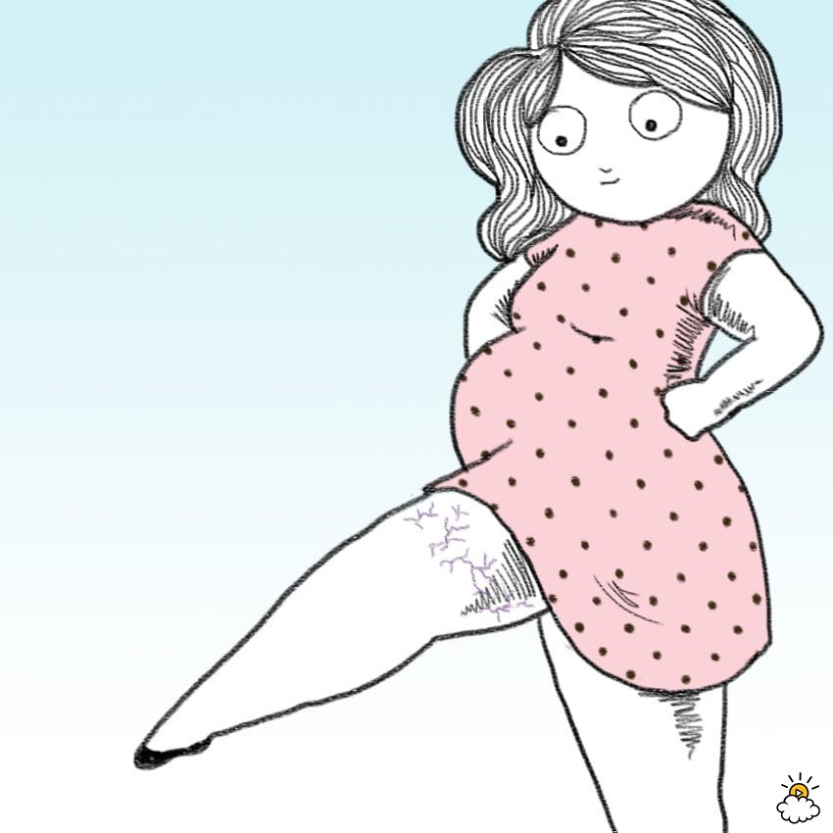
Oedema in pregnancy
A combination of the slight increase in the permeability of the smallest of blood vessels (they allow more fluid to leak out into the tissues), the additional weight of the uterus, and the downward force of gravity, slow down the rate at which blood is pumped back to the heart from the lower half of the body. Fluid often collects in the tissues of the legs and feet of pregnant women after the first trimester, instead of being absorbed into the blood circulation.

Slide 24
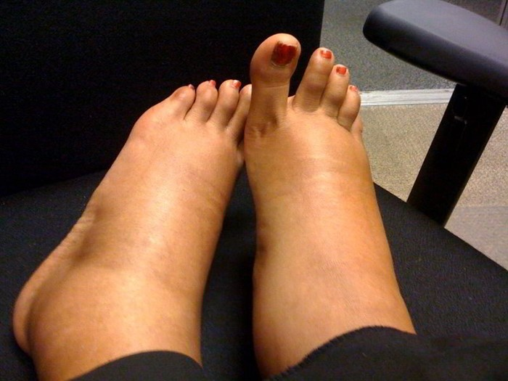
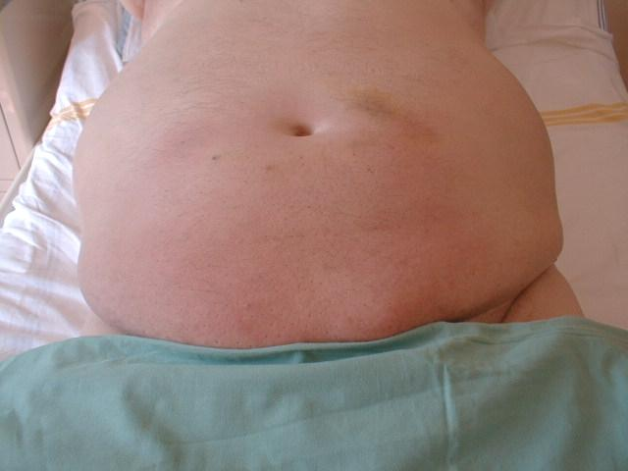
It is a common condition in pregnant women, particularly if they stand for a long time during the day. Oedema of the hands may also occur. Advise the woman to rest frequently and to elevate (raise) her feet and legs while sitting. This will improve the return of blood to her heart and decrease swelling of the legs.
If a pregnant woman experiences severe oedema, including swelling of the face, this is a danger sign that requires immediate referral to the nearest health facility.

Slide 25
Respiratory changes
During pregnancy, the amount of air moved in and out of the lungs increases by nearly 50% due to two factors: each breath contains a larger volume of air, the rate of breathing (breaths per minute) increases slightly.
During pregnancy, many women find they get short of breath (cannot breathe as deeply as usual). This is because the growing baby crowds the mother’s lungs and she has less room to breathe. But if a woman is also weak and tired, or if she is short of breath all of the time, she should be checked for signs of sickness, heart problems, anaemia or poor diet. Get medical advice if you think she may have any of these problems.

Slide 26
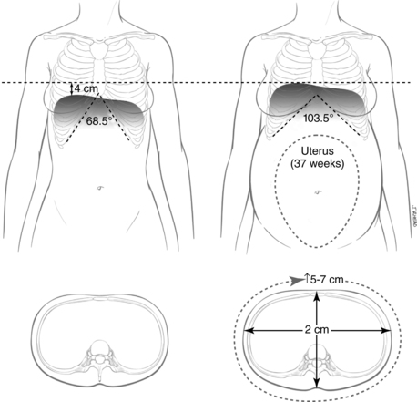

Slide 27
Changes in the gastrointestinal system in pregnancy
During pregnancy, the muscles in the walls of the gastrointestinal system relax slightly, and the rate at which food is squeezed out of the stomach and along the intestines is slowed down.
The growing baby crowds the mother’s stomach and can cause indigestion and heartburn.
Many women also have nausea in the first months of pregnancy. A burning feeling, or pain in the stomach or between the breasts, is called indigestion (or ‘heartburn’, although the heart is not involved). It happens because as the pregnancy progresses, the growing baby crowds the mother’s stomach and pushes it higher than usual. The acids in the mother’s stomach that help digest food are pushed up into her chest, where they cause a burning feeling. This is not dangerous and usually goes away after the birth.
If the mother has difficulty with nausea or indigestion, advise her to eat small, frequent meals. The mother should not lie down flat for 1 to 2 hours after eating, because this may cause these symptoms.

Slide 28
Changes in the urinary system during pregnancy
The urinary system consists of the kidneys, the tubes connecting the kidneys to the bladder where urine is stored, and a tube called the urethra that passes urine out of the body. The kidneys extract waste from the blood and turn it into urine. They must work extra hard to filter the mother’s own waste products from her blood, plus those of the fetus, and get rid of them in her urine. Therefore, there is also an increase in the amount of urine produced during pregnancy.
Needing to urinate (pee) often is normal, especially in the first and last months of pregnancy. This happens because the growing uterus presses against the bladder. In late pregnancy, a woman often has to get up during the night to urinate, because fluid retained in the legs and feet during the day (oedema) is absorbed into the blood circulation when her legs are raised in bed. The kidneys extract the excess fluid and turn it into urine, so the bladder fills more quickly at night.

Slide 29
Changes in the breasts
In early pregnancy, the breasts may feel full or tingle, and they increase in size as pregnancy progresses. The areola around the nipples (the circle of pigmented skin) darkens and the diameter increases. The Montgomery’s glands (the tiny bumps in the areola) enlarge and tend to protrude (stick out more). The surface blood vessels of the breast may become visible due to increased circulation, and this may give a bluish tint to the breasts.
By the 16th week (during the second trimester), the breasts begin to produce colostrum. This is the precursor of breastmilk. It is a yellowish secretion from the nipples, which thickens as pregnancy progresses. It is extremely high in protein and contains antibodies (special proteins produced by the mother’s immune system) that help to protect the newborn baby from infection. Near the end of pregnancy, the nipples may produce enough colostrum to make wet patches on the woman’s clothes. Reassure her that this is normal and a good sign. After the baby is born, colostrum is produced for about the first three days, before the proper milk begins to flow. Make sure that the mother breastfeeds the colostrum to her baby, so he or she gets all the nutrients and antibodies it contains.

Slide 30
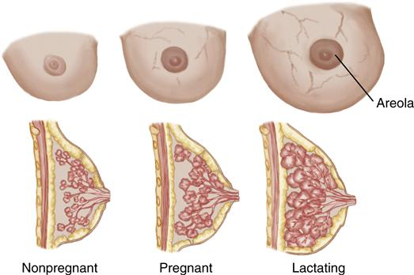

Slide 31
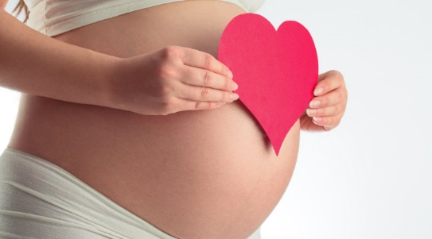
THANK YOU FOR ATTENTION !

