Slide 1
Оrganization of obstetric and gynecological services.
Professor of the department of obstetrics and gynecology
L.E. Radeckaya
Notes:
The course and management of physiological pregnancy

Slide 2
The obstetric and gynecological service in the country is headed
by the Ministry of Health of the Republic of Belarus.

Slide 3
The main healthcare institutions providing
obstetric and gynecological care are:
• maternity hospital as a separate institution or as part of a multidisciplinary hospital
• Clinic for Women;
• obstetric and gynecological departments of regional or other hospitals.

Slide 4
Medical and genetic centers
have been organized in regional centers. Their activities are aimed at the prevention,
timely detection and treatment of hereditary diseases.

Slide 5
Indications for genetic counseling
1. The age of woman ≥ 35 years.
2. The presence of a chromosomal abnormality in one of the partner.
3. The presence of the children with hereditary diseases in the family
4. Marriage between relatives.
5. Harmfull effects in early pregnancy (diseases, diagnostic or therapeutic procedures, taking medications, ..). ….

Slide 6
If the pregnant woman has obstetric pathology, she is hospitalized in the ward for pregnant women of the obstetric hospital.
In case of extragenital pathology, they are hospitalized routinely in the somatic department according the disease profile or in the obstetric hospital (depending on the gestational age and the severity of the disease).

Slide 7
Arterial hypertension
Hospitalization
To the cardiological department :
before 12,
at 18-20,
At 28-32 weeks of pregnancy.
To the obstetric hospital - at 38 weeks of pregnancy: to determine the term and choose the method of delivery.

Slide 8
Diabetes mellitus
Planned (Scheduled, routine) hospitalization in the endocrinological department
Up to 12 weeks,
at 20-22,
28-32,
36-38 weeks (in case of insulin therapy).

Slide 9
Currently, the obstetric care system in the Republic of Belarus has a structure of 3 levels.
The purpose of this system is to ensure timely hospitalization of mothers and newborns with pathology to appropriate medical institutions that are able to provide high−quality medical care based on the complexity of the obstetric situation and the health status of the newborn.

Slide 10
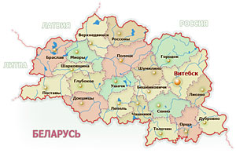
The I level of care
is the central district hospital, which has a clinic for women, an obstetric department and a children's department.
Healthy pregnant women are hospitalized

Slide 11
Level II interdistrict perinatal center. They provide special care for newborns. 24-hours duty of obstetrician and gynecologist, anesthesiologist, neonatologist.
Level III – regional centers. 24-hours duty of neonatologist-resuscitator (except above).

Slide 12
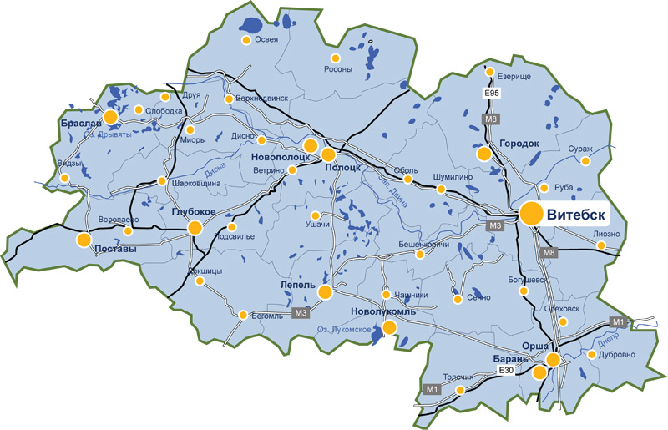
Level II interdistrict center. Special care for newborns. 24-hours duty of OG, AR, neonatologist. (Orsha, Polock).
Level III – regional
centers. 24-hours
duty of neonatologist-resuscitator (except above).

Slide 13
A special order from the Ministry of Health of the Republic of Belarus divides all pregnant women into groups and indicates which ones should be sent for hospitalization.

Slide 14
Dispancerisation (Medical examination) of pregnant women
is carried out in a clinic for women, in accordance with current normative documents.
The main principles are:
comprehensive examination of pregnant women,
medical control over the state of health of the woman, the course of pregnancy,
the provision of preventive and curative care to both mother and fetus.

Slide 15
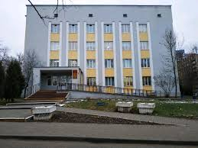
Clinic for women
The organization of the work of it is based on the territorial-participation (territorial-site) principle.
One obstetric-gynecological site corresponds to two therapeutic sites.

Slide 16
Large clinic for women organize offices for specialized obstetric and gynaecological care:
prenatal care of fetal wellbening,
oncoprophylaxis (cervical pathology),
mammologist,
endocrine disorders , menopause pathology,
family planning,
miscarriage, and others.
If conditions are available, a day-care hospital for pregnant and gynecological patients is organized.

Slide 17
Thank you for attention!

